Slide 1
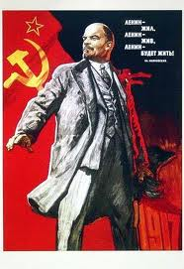
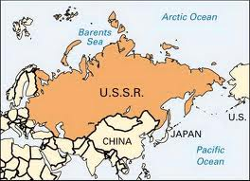
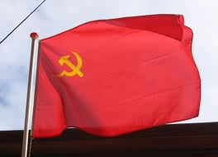
Russian Revolution – 1917 How the Soviet Union was created

Slide 2
What was the sequence of events that led to the creation of the Soviet Union?
Take the adjacent events and correctly sequence them on a timeline from 1905-1917
Create a textbox for each & add key facts
Bloody Sunday
March Revolution
November Revolution
Provisional Gov’t Created
Russian Civil War
Russo-Japanese War
Treaty of Versailles
Treaty of Brest-Litovsk
USSR Created
WW1 begins

Slide 3
Causes > 1917 Russian Rev > Effects
Causes
Discontent w/ Romanov rule
Revolutionary ideas
Russian Revolution
1917
March Revolution
Bolshevik Revolution
Effects
Abdication of Czar Nicholas II
Weak leadership by Czar
Humiliating defeats in Russo-Jap War & WW1
Rich-Poor Gap between nobility & peasants
Provisional Gov’t Kerensky=pro-war
Democracy v. Communism ??
Civil War 1917-20 Reds vs. White
Lenin “USSR!”
Lenin proclaims “Dictatorship of the Proletariat”
Bolsheviks + Soviets revolt!!
Riots
Lenin returns

Slide 4
Lenin’s Dictatorship of Proletariat
Eliminate via Terror
Crush Dissent
Murder Czar
Solidify Power
Outlaw Religion
Establish Nation
USSR
Leningrad
Comintern
Communist Party Rules
Control
Nationalize Economy > NEP
State Info Control “Propaganda”
Communist Reorganization

Slide 5
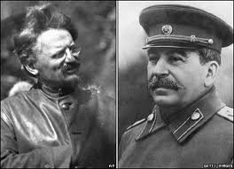
Lenin dies 1924… Now What?
Stalin rises
Stalin masters party politics
Trotsky out
Trotsky exile
Stalin rules
Stalin
Right Wing
NEP slow growth
Trotsky
Left Wing
Industry Now
De-centralization
Focus on Russia
Collectivize Farms
Dissent Allowed in Communist Party

Slide 6
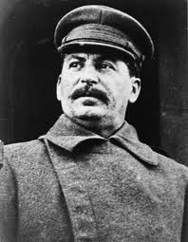
USSR under Stalin
Farm Collectivization
State owns + Modernized + Export
Terror
Kill opponents
Exile to Gulags
Great Purge ‘ 30s
Industrialization
5 Yr Plan
Soviet Catch-up
Consumers ☹

Slide 7
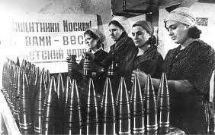
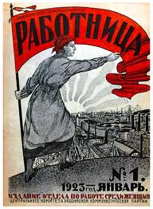
Family Life in the USSR
Greater equality for women
Political rights = Vote
Political positions in Communist Party
Higher Education
Secular marriage = No religious ceremony
Increased divorce, domestic violence & abandonment
Equal child rights = No bastards!
Legal abortion
State run Education
Gender Double Standard still exists ☹

