Slide 1
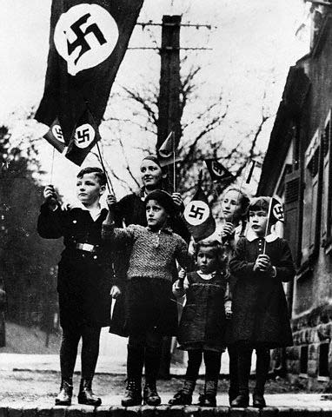
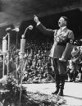
Germany & the Rise of National Socialism
How the Nazi Party Came to Power
&
What They Did

Slide 2
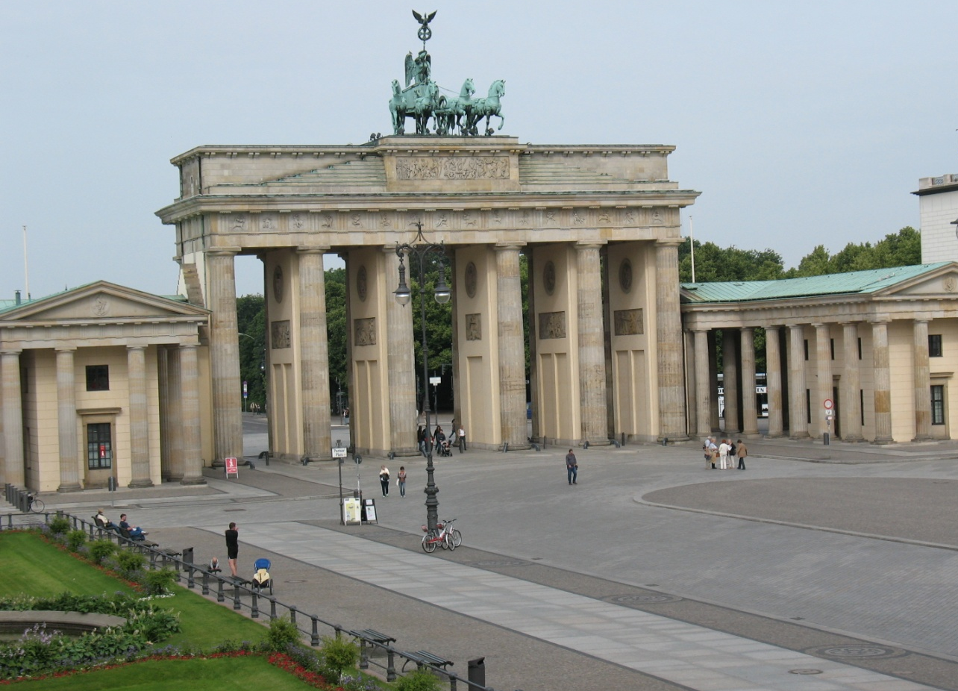
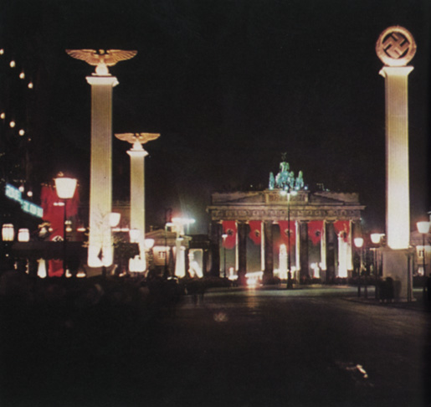
Brandenburg Gate - Berlin

Slide 3
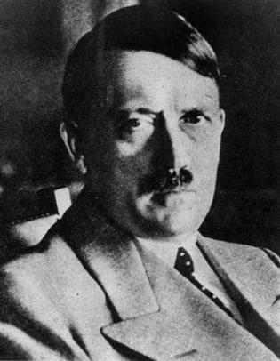
Adolf Hitler: Who is this guy?
Born 4/20/1889, Austria
HS drop-out
Failed art student
No trade or career
Lived off relatives $$
WW1 vet
No real friends
Adapted ideas of others
Failed revolutionary

Slide 4
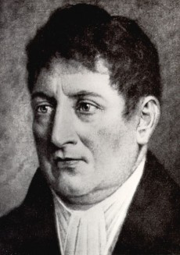
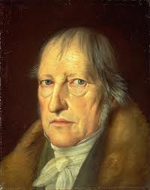
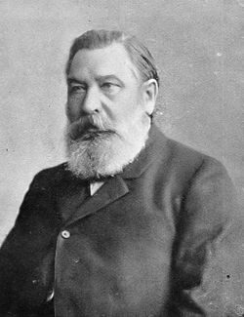
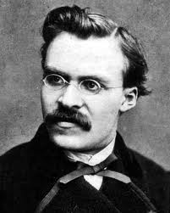
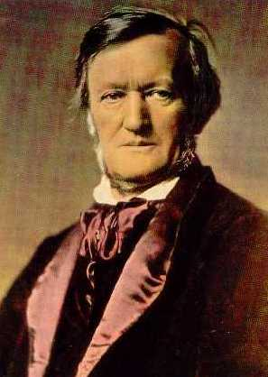
Whose ideas influenced Hitler?
Johann G. Fichte (early 1800s)
Germanic superiority
Georg WF Hegel (mid-1800s)
State is #1, people serve the State
Heinrich von Treitschke (late 1800s)
Obedience to the State
War is Man at his finest
Friedrich Nietzsche
Struggle = Life , Übermensch
Richard Wagner
Anti-Semitic / German Romanticism

Slide 5
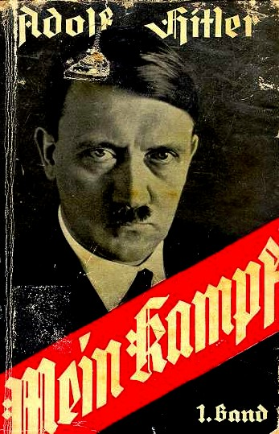
What did Hitler believe?
Struggle (Darwin)
Competition / Force / Win
Race Theory (Social Darwinism)
Aryan supremacy
Racial Purity / the Volk = elite
Anti-Semitism / anti-weak / anti-other
Strong Leadership (Fascist)
Anti-Democracy / Anti-Communist
Fűhrer embodies the Volk
Mission + Responsibility

Slide 6
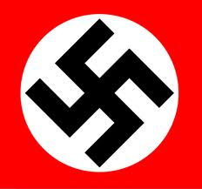
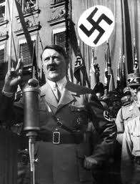
Hitler's Path to Dictatorship…
Joined German Workers Party 1919
Led by early 1920s > Δ to NSDAP = “NAZI”
Failed Munich Putsch 1923 = “prison”
Mein Kampf = Fame / $$
NAZI propaganda + SA Violence = Votes!
Hitler 2nd in ‘32 presidential vote
NAZIs top party, but no majority
Coalition deal?

Slide 7
Chancellor Hitler

Slide 8
Hitler's Path to Dictatorship…
Hindenburg = President, aging
Von Papen = Chancellor, but..
“No confidence” vote, No Army support
Hitler named Chancellor 1/30/1933
Reichstag Fire > Enabling Act = Dictator
Blood Purge 1934 v. internal NAZI dissent
Ernst Röhm + other SA leaders = dead!
Gestapo + SS (elite)

Slide 9
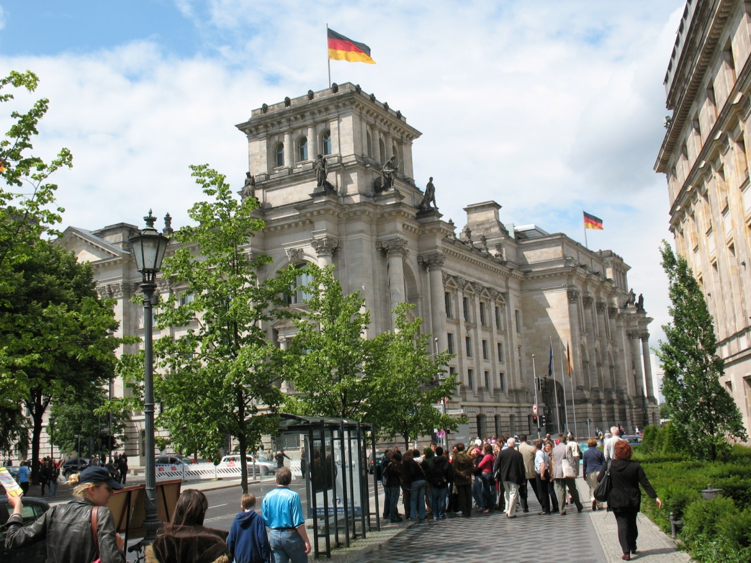
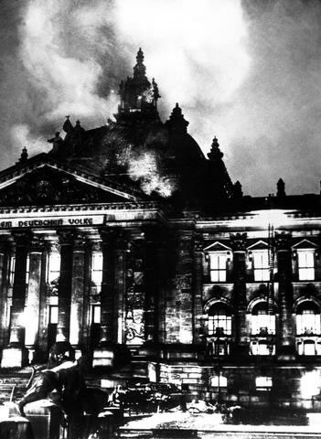

Slide 10
Hitler's early actions…
Purify & Strengthen Germany
Book burning + propaganda + laws
Persecution of Jews, intellectuals, dissidents, communists, unionists, etc.
Show Trials >> Concentration Camps
Improve Life
Reichsautobahn built = employment
Compulsory Labor Service (RAD) = U
Restore German pride
Propaganda + Re-arm + Hitler Youth

Slide 11
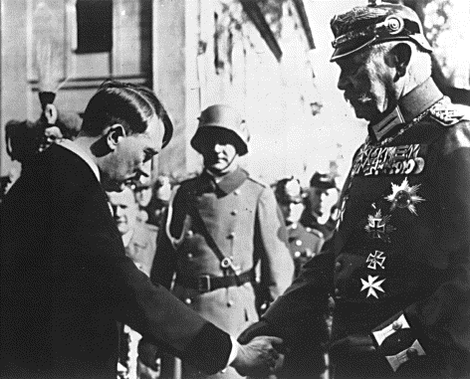
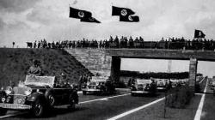
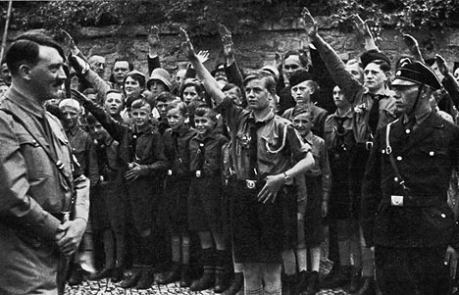
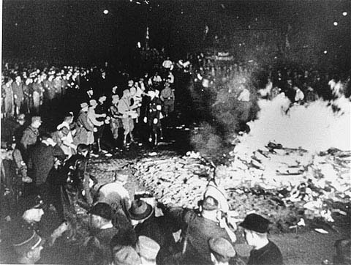

Slide 12
How can this happen?
(S) Collapse of traditions = apathy, loss
WW1 humiliation = anger
Foreign occupation = anger
(P) Poor political leadership = confusion
(R) Church had no answers = no hope
( I ) Intellectual “outsiders” arise = Hitler
(T) Mass media use = propaganda
(E) Economic stress = desperation
Reparations + Hyper-inflation + Ū

Slide 13
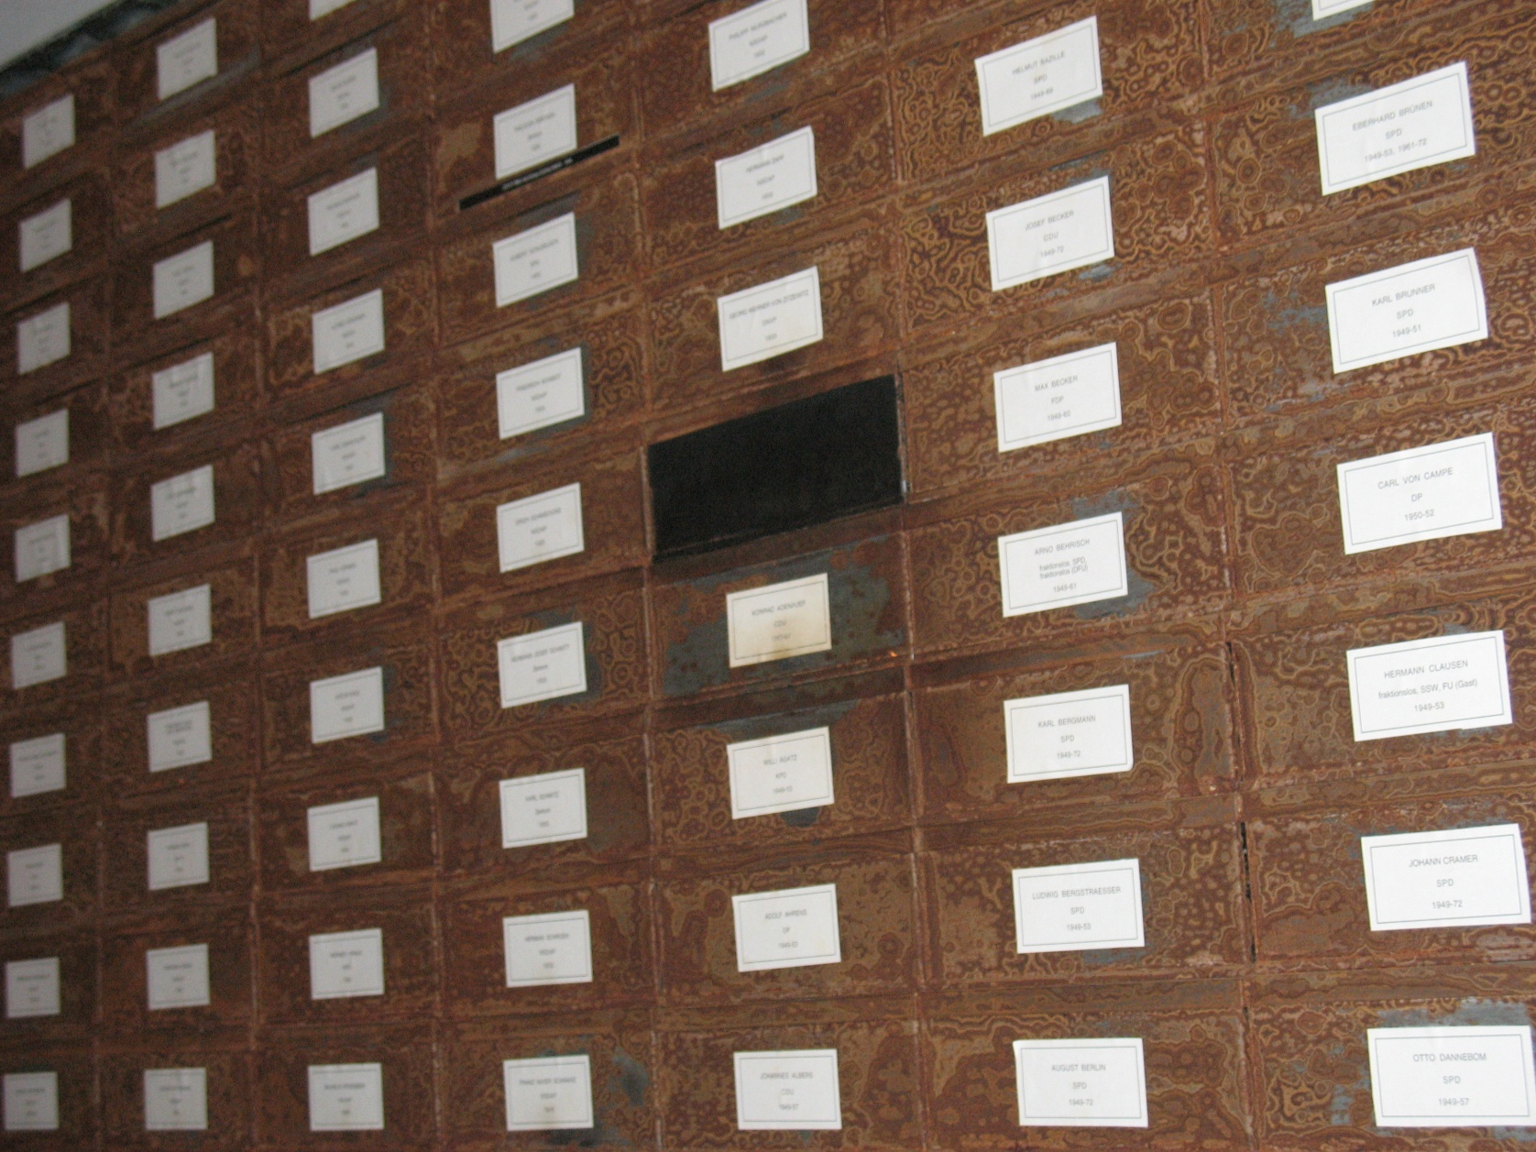
Hitler is the "dark Spot" in German history…

