Slide 1
Crises in the Late Medieval Church
Ms. Susan M. Pojer Horace Greeley H. S. Chappaqua, NY
Adapted by R. Kolodinski, Glendale HS, Glendale CA

Slide 2
Decline in the Medieval Church
Spiritual Authority
Political & Spiritual Poverty
Temporal Authority
Papal Plentitude of Power = Secular Papal Monarchy
NO taxing the clergy by State [Clericis Laicos] - 1296
Rota Romana = Church courts… vs. Royal courts -
Papal Bull [Unam Sanctam] = Church over State - 1302
Marsilius of Padua [Defensor Pacis] = Critic of Papal Abuse of Power- 1324

Slide 3
Specific Crises
New Heresies.
Schism.
Lay Reform.
Conciliarism.

Slide 4
Decline in the Medieval Church
Heresies
Official Church Beliefs
Theological Differences
John Wycliffe
Lollards
England
John Huss
Hussites
Bohemia

Slide 5
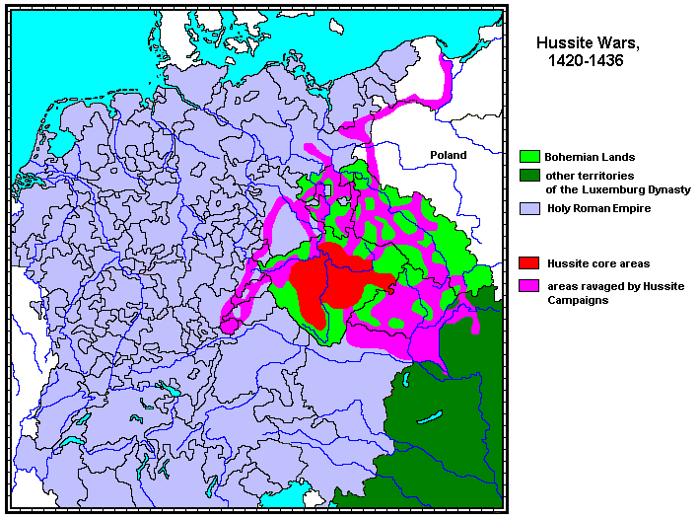
The Hussite Wars [1420-1436]

Slide 6
Decline in the Medieval Church
Popes
Church Councils
= Conciliarism
Internal Church Power
Innocent III
Boniface VIII
The Avignon Papacy [1309-1377]
Pisa
Constance
Basel

Slide 7
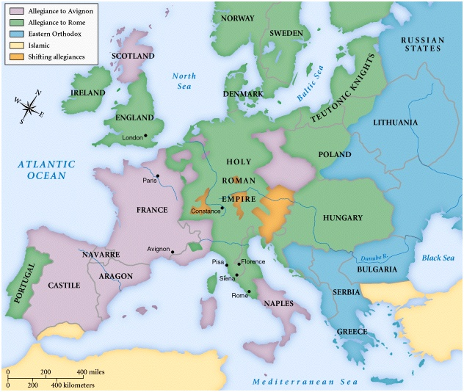
The Great Schism: 1378-1417

Slide 8
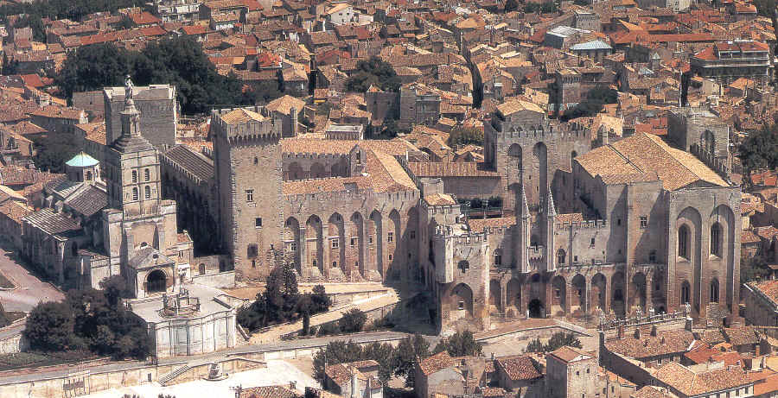
The Avignon Papal Complex

Slide 9
Decline in the Medieval Church
REASON Roger Bacon &
William of Ockham
FAITH Scholasticism
Intellectual Inquiry
Peter Abelard [Sic et Non]
Doctrinal debate
Thomas Aquinas [Summa Theologica]… Faith plus reason = Harmony

Slide 10
Decline in the Medieval Church
Church Corruption
Individual Piety
Religious Devotion
Inquisition
Rich Monasteries
Benefices
Annates
Indulgences
Lay Devotions
Beguines
Beghards

