Slide 1
The West Before 1300
A Lack of Order
&
Stabilizing Forces

Slide 2
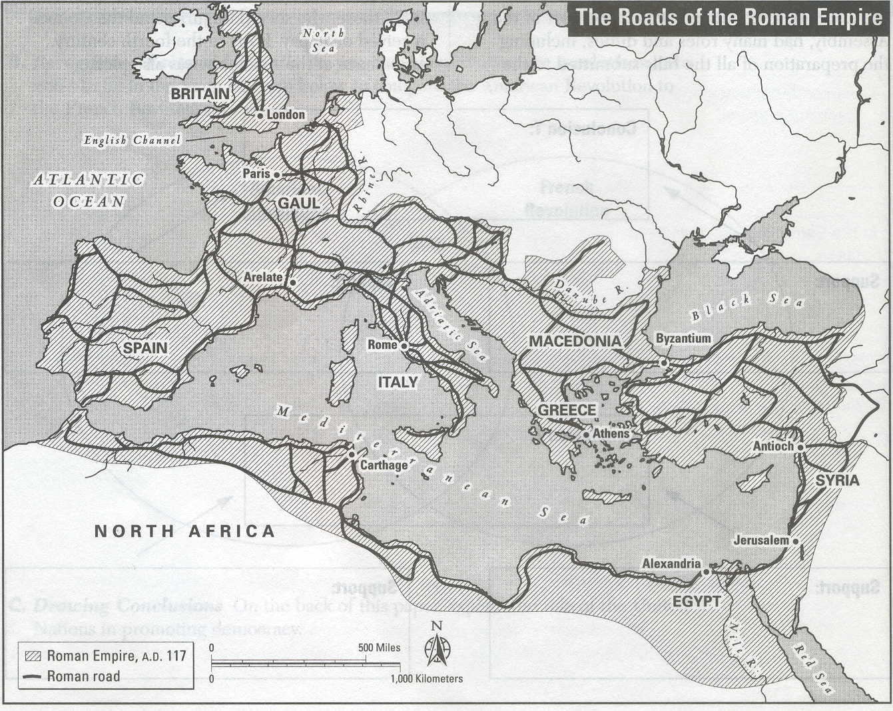
What does this document tell you?

Slide 3
What was Rome’s Legacy to Europe?
Order + Culture + Safety + Trade
Empire Split > Western + Byzantine
West Falls 476 CE, now what?
Barbarians control former W empire
Church Split > Roman Catholic (W) v. Orthodox (E)
Islamic State ↑ in Middle East & N Africa
Attempts to conquer Europe
Which leaves Europe in a state of…??

Slide 4
Why was the RC Church critical to Europe during the Middle Ages?
Brought order to chaos
Maintained culture & learning
Monasticism >> Rise in Church power
RC Church develops political role
United the various political groups
Holy Roman Empire under Charlemagne
Organized resistance vs. attempted Muslim conquest of Europe
Crusades + Defense cities & alliances

Slide 5
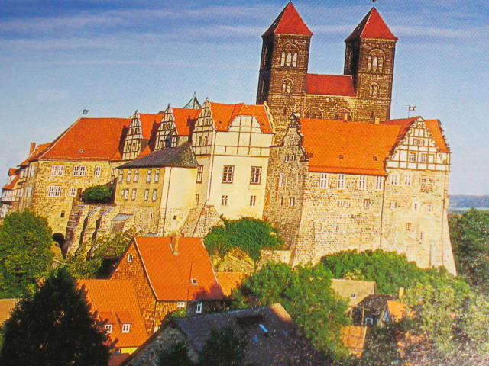
Feudalism
= Political + Military + Social + Economic system of medieval Europe
Lord over Vassals over Knights & Serfs
Fealty Oath + acts of loyalty gains one a Fief + Manor

Slide 6
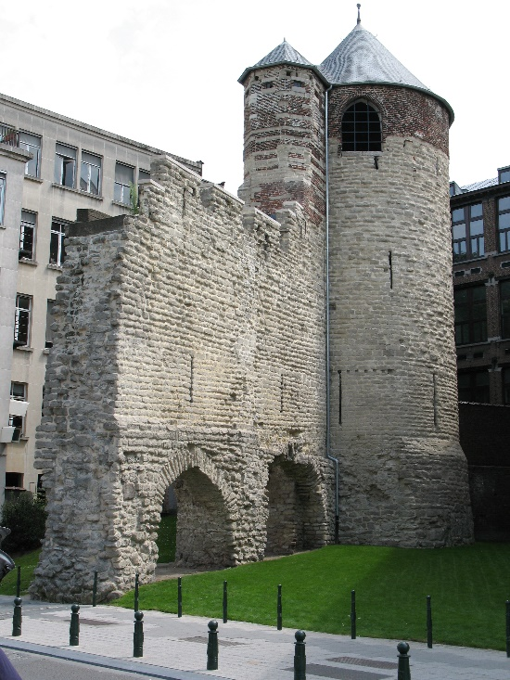
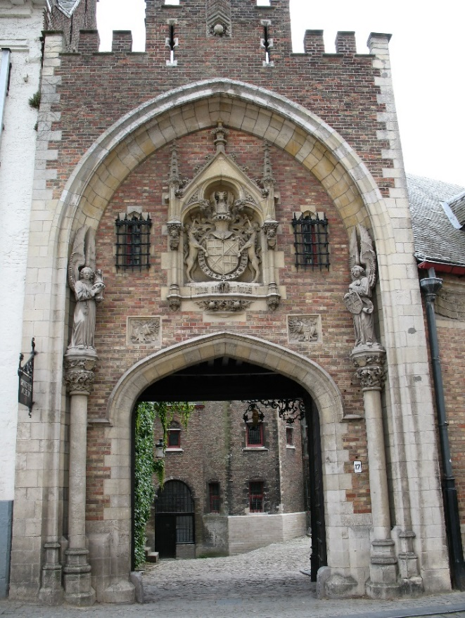
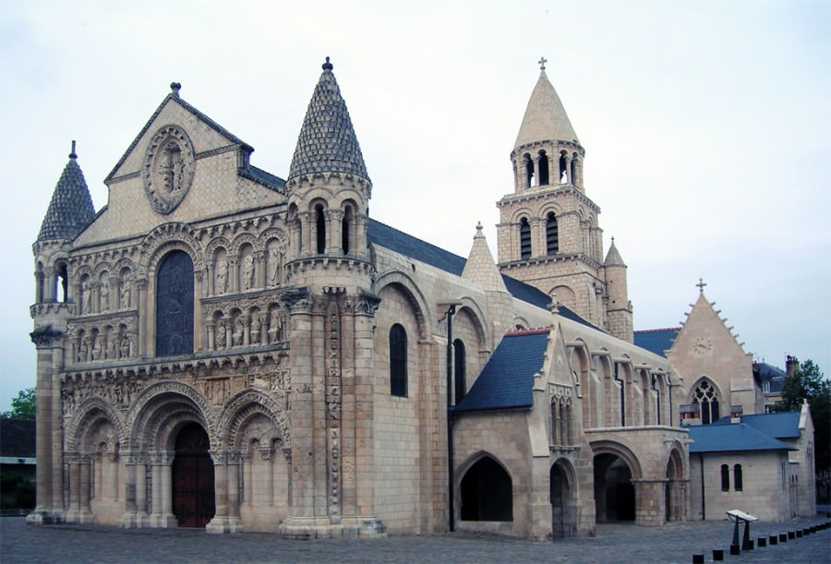
Medieval Romanesque Architecture
Heavy, Massive Walls, Small Windows, Solid

Slide 7
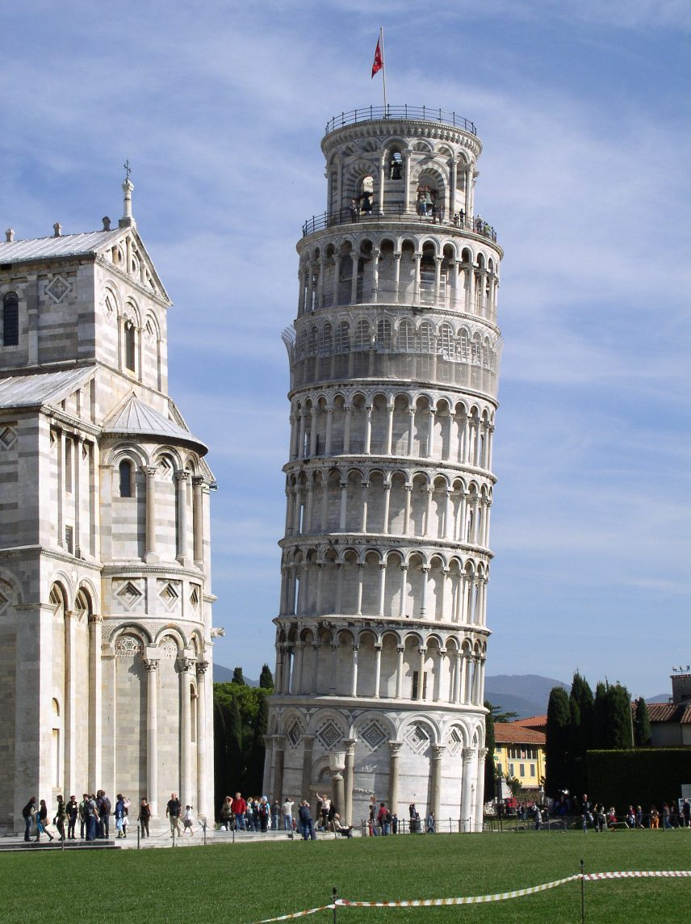
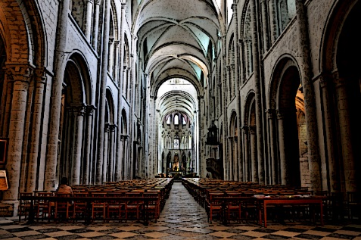
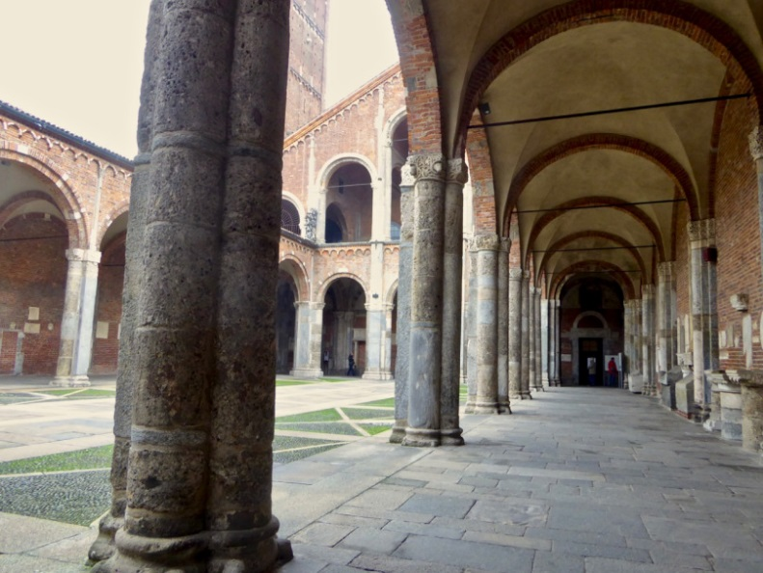
More Romanesque

Slide 8
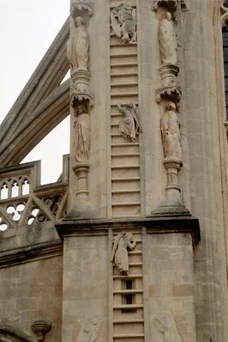
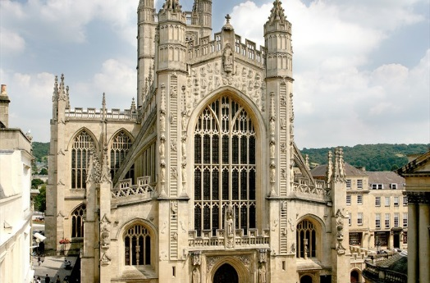
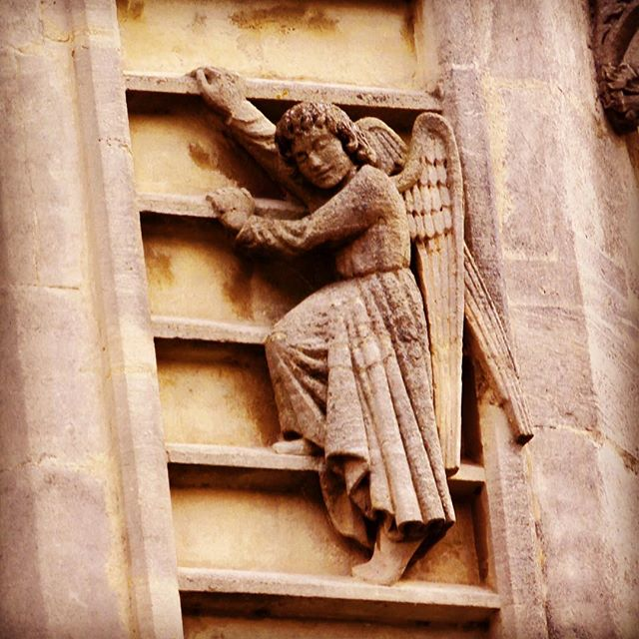
Medieval Gothic Architecture
Pointed arch, Flying Buttress, Spires, Gargoyles, Angels & More Glass

Slide 9
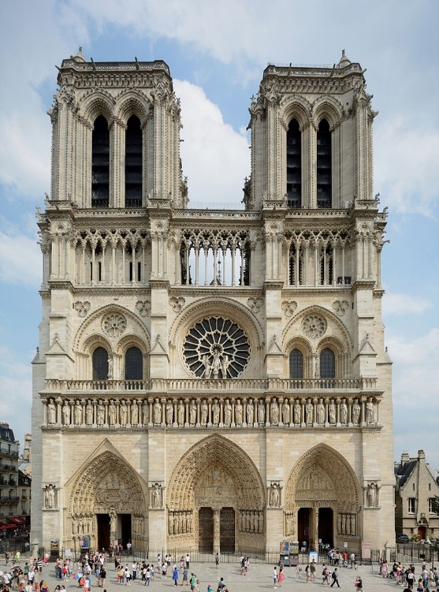
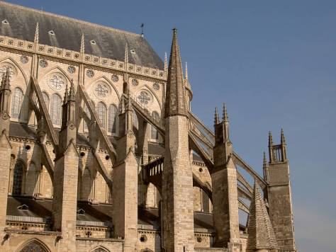
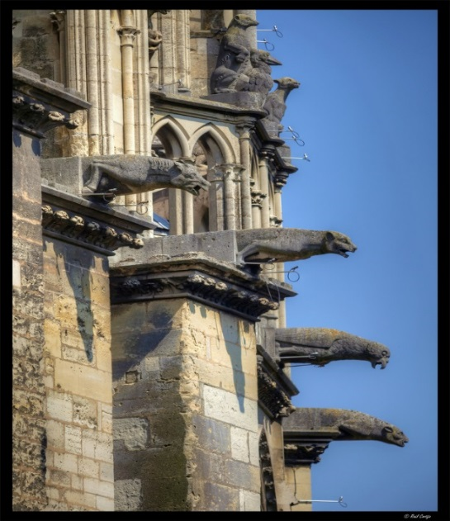
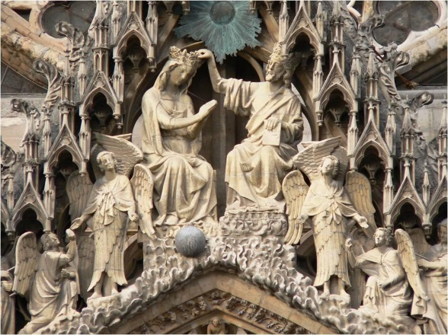
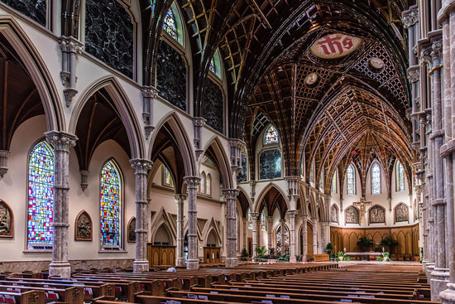
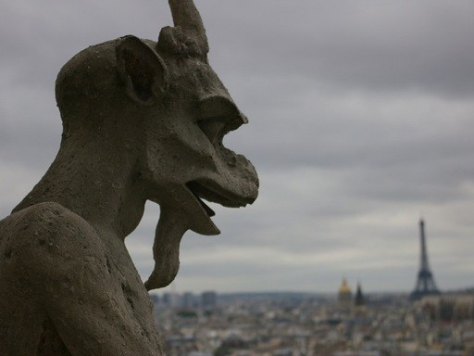
More Gothic

Slide 10
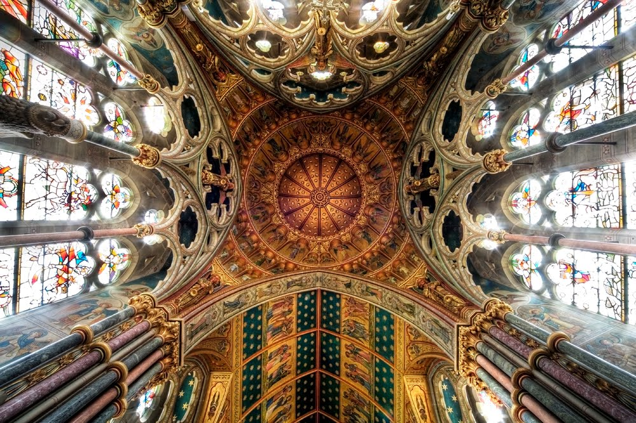
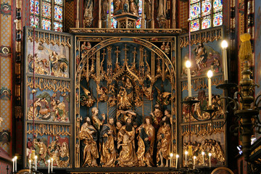
More Gothic
St. Mary’s Basilica
Krakow, Poland
What makes it gothic?

Slide 11
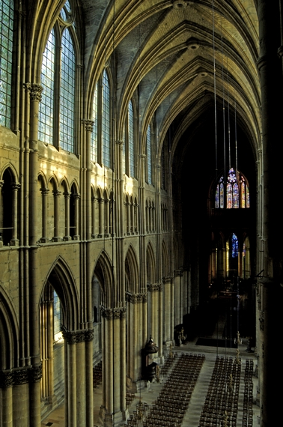
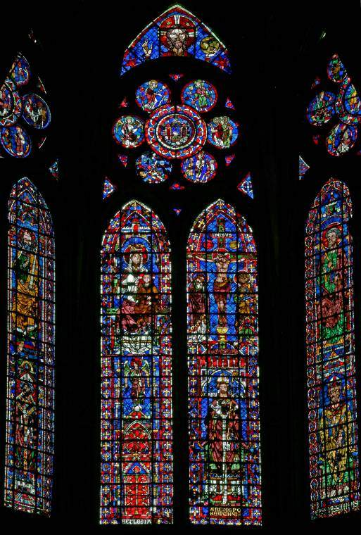
Gothic Interior

Slide 12
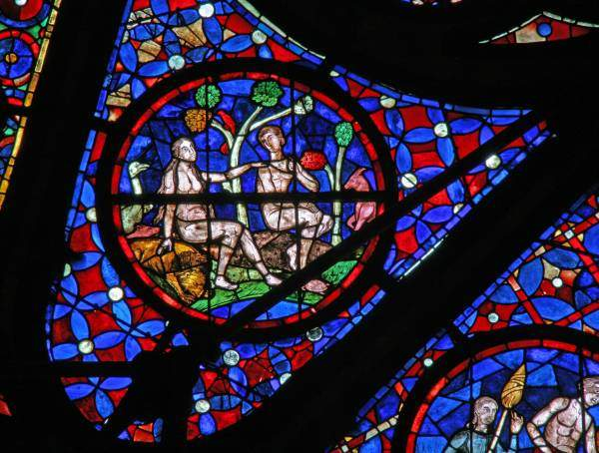
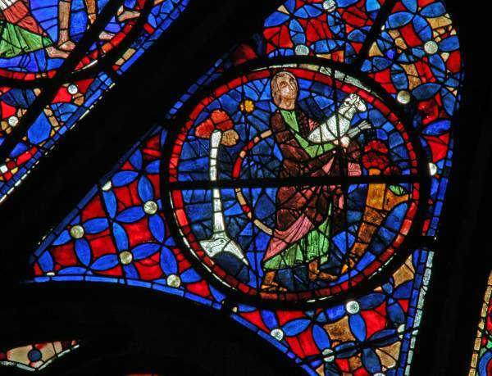
Medieval Art Style
Why stained glass?

Slide 13
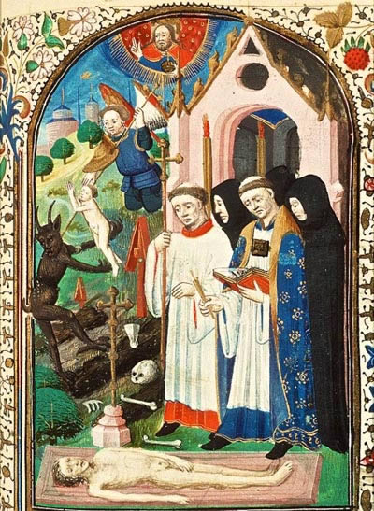
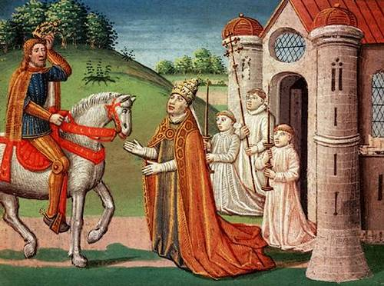
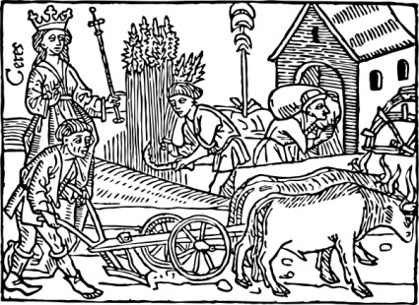
Medieval Art, how would you describe it?

Slide 14
Middle Ages & Renewal
Towns + Trade re-emerge with stability
Venice / Genoa / Pisa… X-roads
Bourgeois Class = Merchants >> Guilds
Monarchy rises
England / France / HRE / Spain
Education
Spanish Muslim contribution in math / science
University “Liberal Arts” courses of study
Scholasticism = Dialectic & Debate

Slide 15
What issues may arise with…
The fall of Rome?
The attempted Muslim conquest?
The rise of feudalism?

