Slide 1
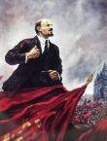
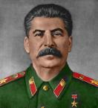
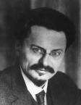
Russian Revolution 1917
How the Soviet Union was created

Slide 2
Causes > 1917 Russian Rev > Effects
Causes
Discontent w/ Romanov rule
Revolutionary ideas
Russian Revolution
1917
March Revolution
Bolshevik Revolution
Effects
Nicholas II Abdicates
Weak leadership
Humiliation in Russo-Jap War & WW1
Rich-Poor Gap between nobility & peasants
Provisional Gov’t Kerensky = WW1
Democracy v. Communism
Civil War 1917-20 Reds vs. White
Lenin “USSR!”
Lenin proclaims “Dictatorship of the Proletariat”
Bolsheviks + Soviets revolt
Riots
Lenin returns

Slide 3
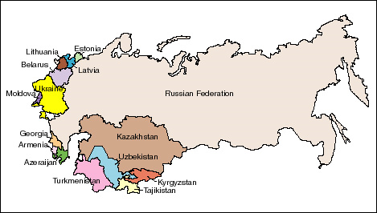
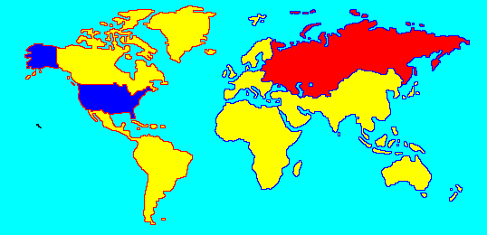
The Soviet Union

Slide 4
Lenin’s Dictatorship of the Proletariat
Eliminate Opposition
By murder of Romanovs
By persecuting Church
Control
Government by Bolshevik rule
Info by Propaganda + Censor
Gain Legitimacy
ComIntern > Global Revolt!
Create USSR… NEW!
By crushing dissent
Economy by Nationalizing + NEP (temporary capitalism)
Eliminate past… Moscow!
Cult of Personality

Slide 5
Lenin dies 1924 > Stalin emerges
Life under Stalin
Collectivization
Land Seizure
Modernization
Export Food
Life No Better
Industrialization
USSR Catch –Up
5 Year Plan
Quota
Consumer Suffers
Terrorize Opposition
Murder
Gulags
Great Purge: ‘30s

Slide 6
Totalitarianism in the USSR… Government control ↑, Rights ↓
What did Lenin do to create the Soviet Union and solidify power in the State?
How did Stalin catch the USSR up with the nations of the West?
What are the consequences of each leader’s actions?
Evaluate each leader…

