Slide 1
The
Dutch
"Golden Age"
(1580s - 1670s)
By Ms. Susan M. Pojer Horace Greeley HS Chappaqua, NY Adapted by: Reiner Kolodinski

Slide 2
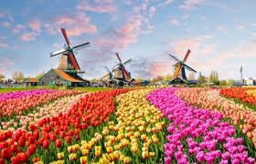
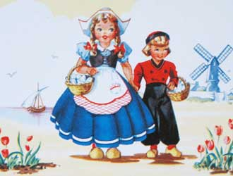
Quote from Willem, a Dutchman in America
“If it aint’ Dutch,
It ain’t much”
Why would he believe and say such a thing?

Slide 3
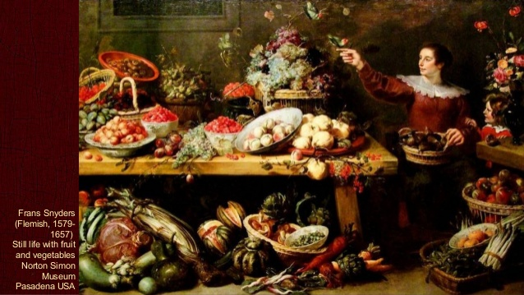

Slide 4
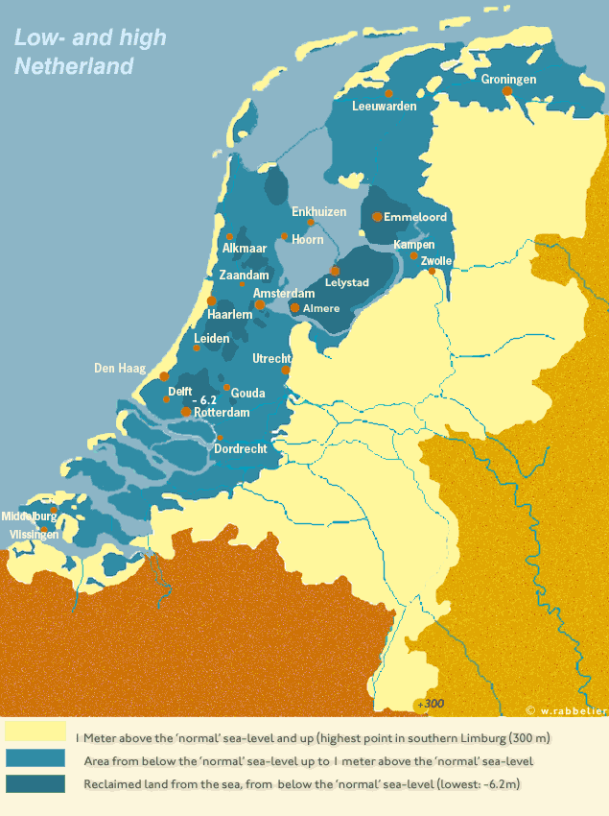
Natural Port Cities =Amsterdam & Rotterdam Trade!
The Netherlands: The “Low Country”

Slide 5
17c: The “Dutch” Century
It was a political model… republic
A passionate attitude towards religion in the country
A level of religious toleration
Stable, thriving economy
“Golden Age” of artists & thinkers.
Religion and everyday life were recurring themes in their art.

Slide 6
Dutch
Society

Slide 7
Dutch Society
Amsterdam, Rotterdam: granaries with enough surplus for one year.
Generally higher salaries than in any other parts of W. Europe.
Even women had higher wages.
“Protestant work ethic.”
Thrift and frugality.
Had the highest standard of living in Europe!

Slide 8
Dutch Art: Communicating About Society
Historical: Biblical, Mythology, History
Prestigious, Master Status
Landscape / Cityscape
Genre
Portraiture
Maritime
Still Life

Slide 9
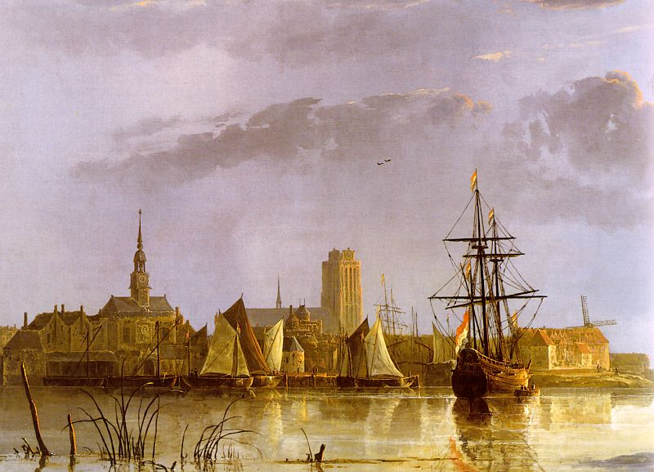
View of Doerdrecht Aelbert Cuyp, 1650s

Slide 10
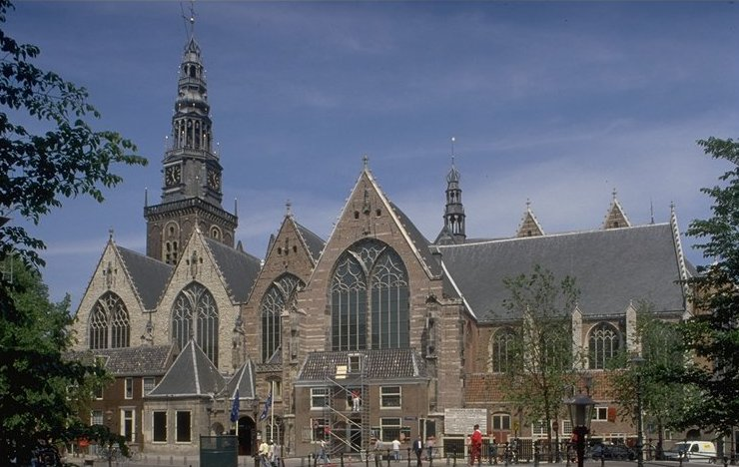
Oude Kerk [Old Church], Amsterdam
First built in 1300.

Slide 11
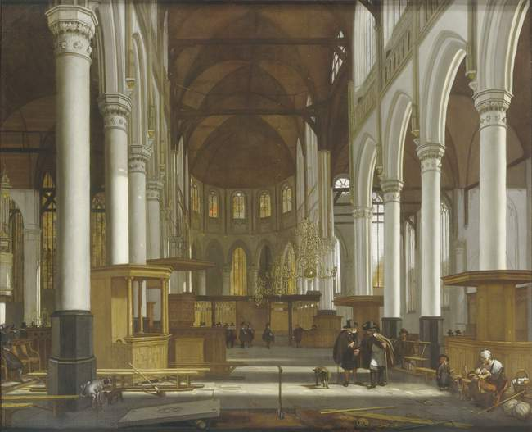
Interior of the Oude Kerk in Amsterdam - Emmanuel De Witt

Slide 12
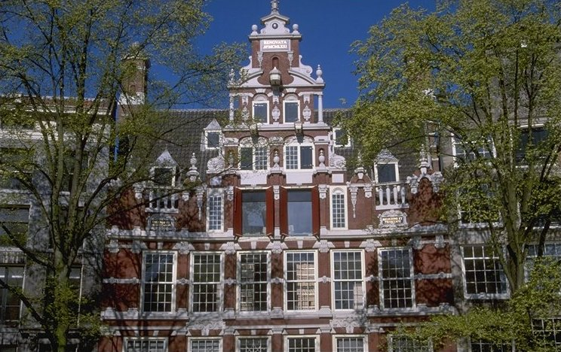
Upper-class Homes, Amsterdam Early 1600s

Slide 13
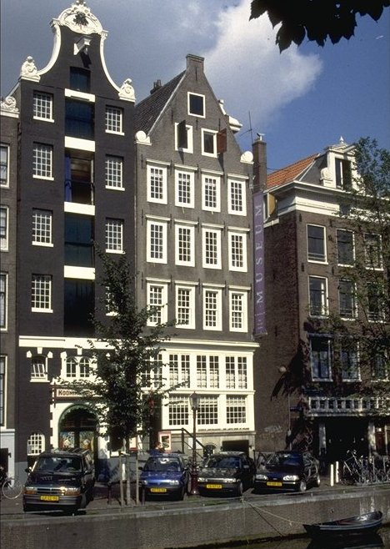
Catholic “Hidden” Church in the Attic, Amsterdam, 1630s

Slide 14
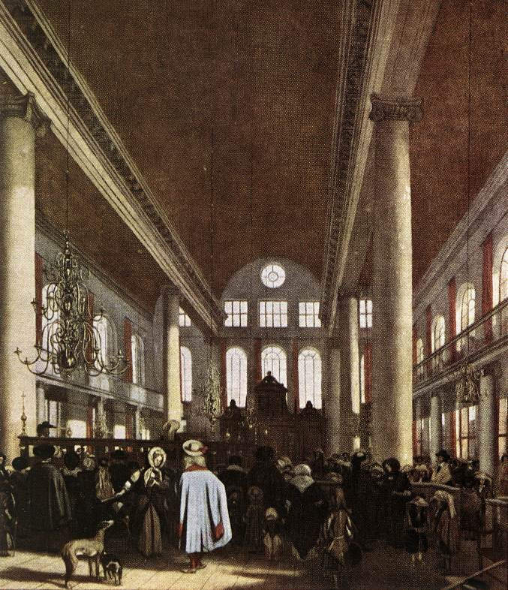
Interior of a Portuguese Synagogue in Amsterdam – Emmanuel De Witte

Slide 15
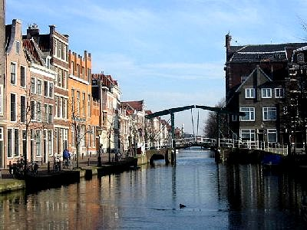
Patrician Houses Along the Canal in Leiden

Slide 16
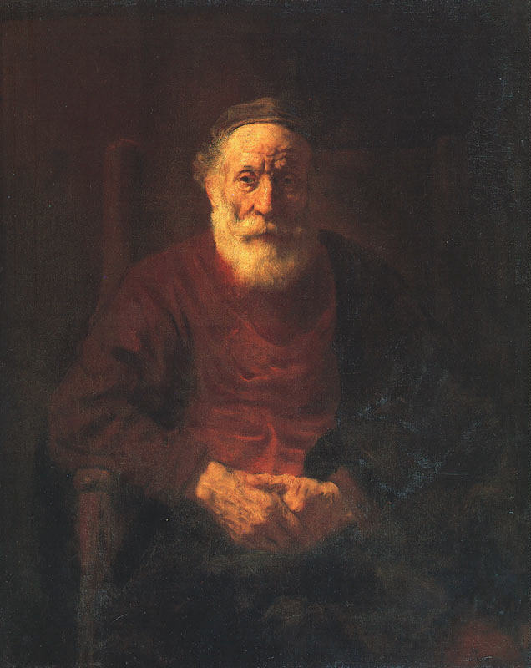
Portrait of an Old Jewish Man Rembrandt, 1654

Slide 17
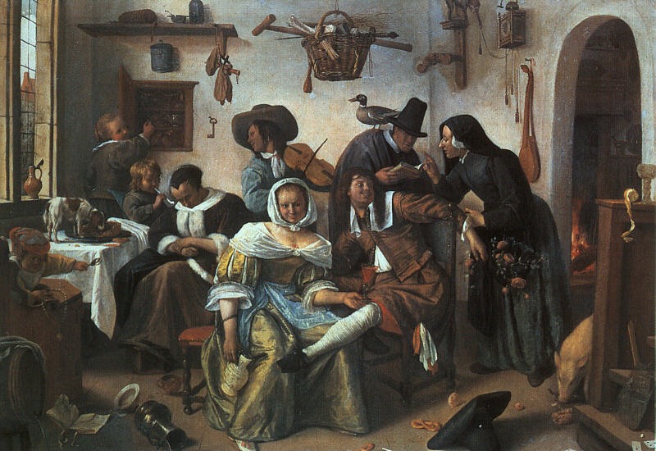
Beware of Luxury – Jan Steen
“Genre” Painting

Slide 18
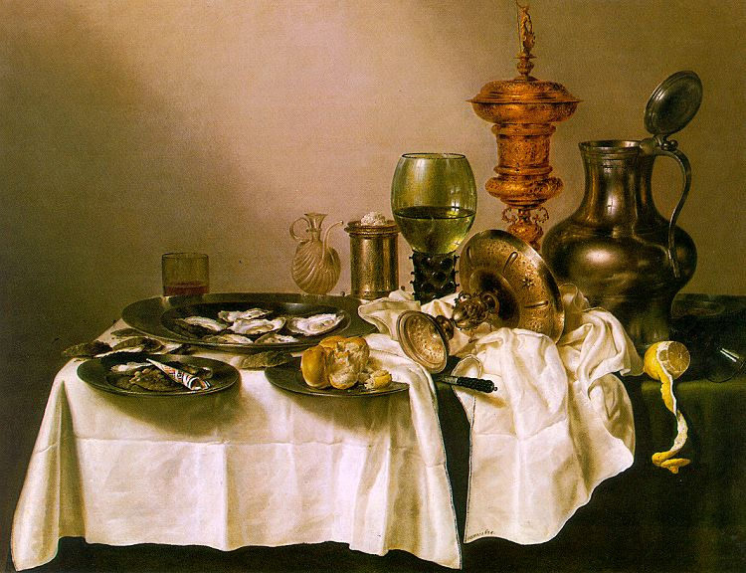
Still Life with Gilt Goblet William Heda, 1635
“Genre” Painting

Slide 19
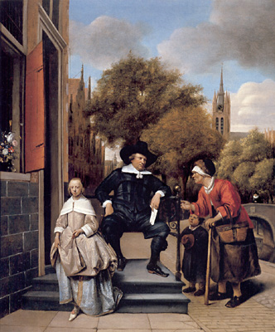
The Burgher of Delft & His Daughter – Jan Steen

Slide 20
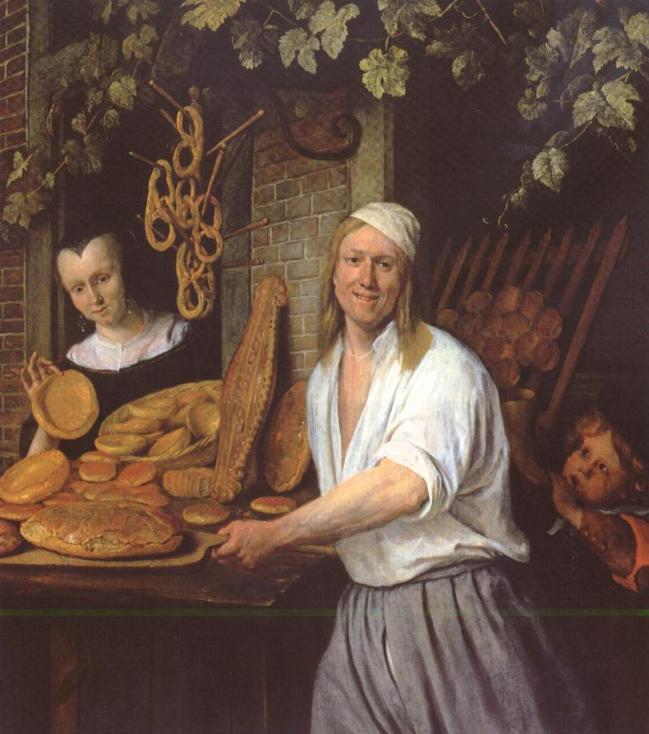
The Leiden Baker & His Wife Jan Steen

Slide 21
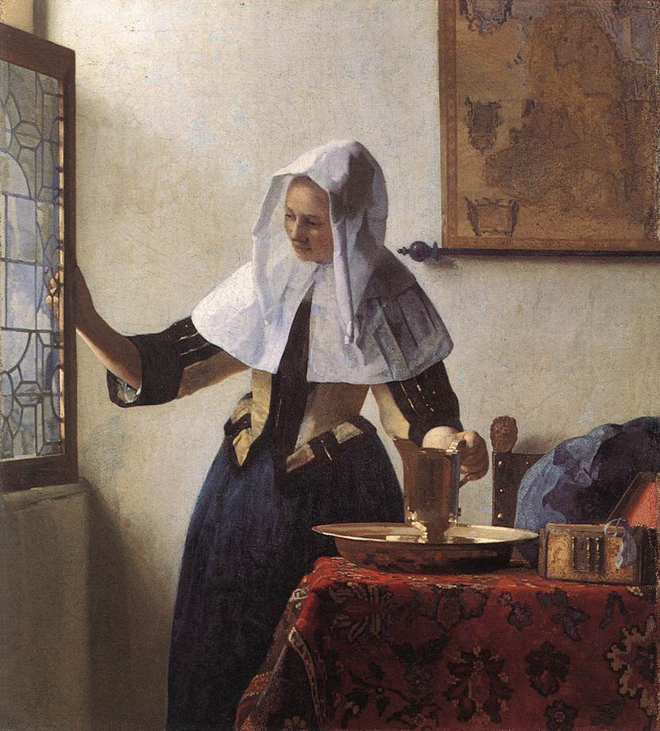
A Young Woman with a Water Jug - Jan Vermeer, 1662

Slide 22
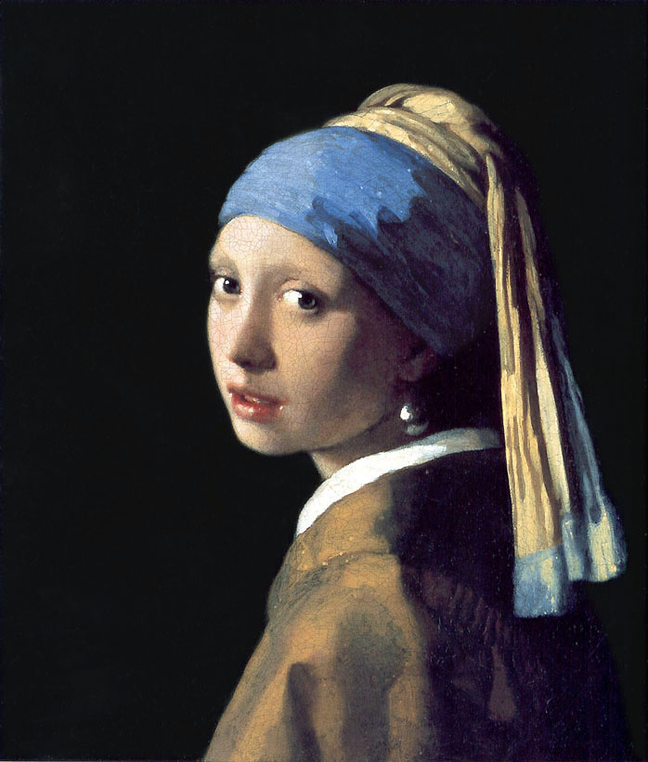
Girl with a Pearl Earring Jan Vermeer, 1665

Slide 23
THe
Dutch
Economy

Slide 24
The Dutch Economy
Exported diamonds, linens, lace, pottery / porcelain.
Low inflation.
Great Dutch land reclamation project was accelerated during this time.
Masters of the “carrying trade” (lowest shipping rates in Europe).

Slide 25
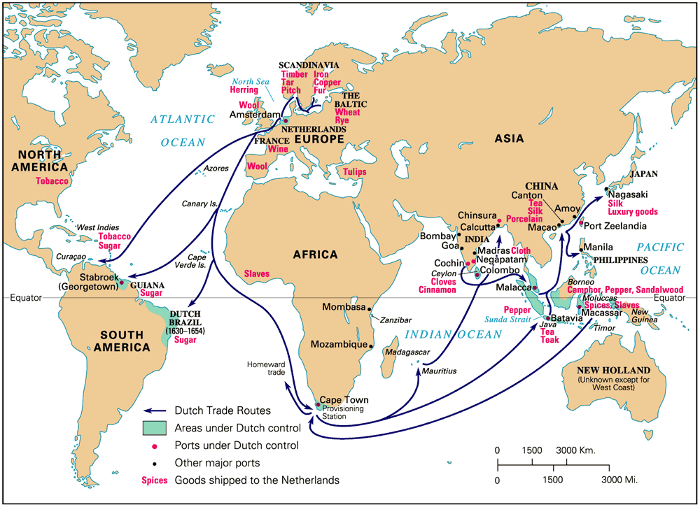
17c Dutch Global Commerce

Slide 26
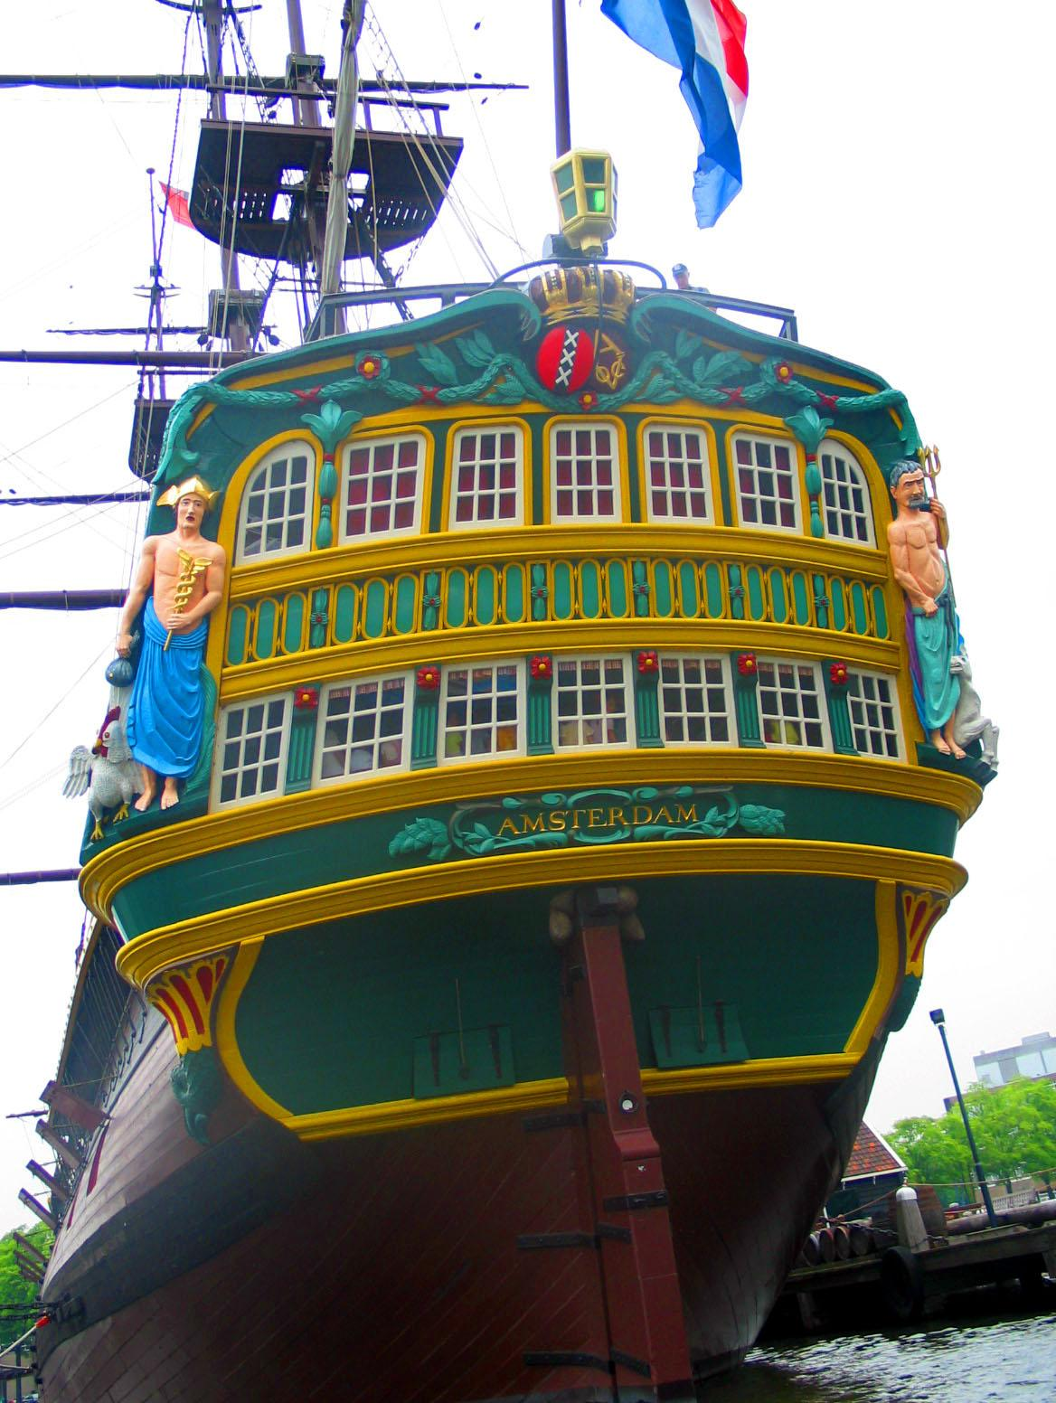
Dutch East India Ship, mid-17c

Slide 27
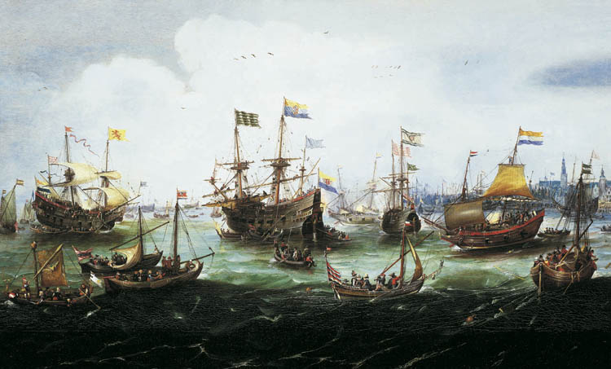
Return of the Dutch East India Fleet, 1599

Slide 28
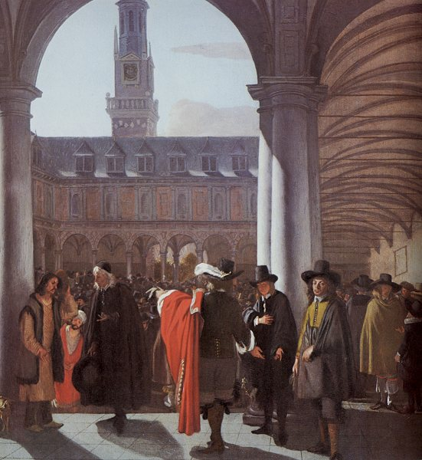
Amsterdam Stock Market (Bourse) Emmanuel De Witte, 1653
Jewish refugees helped found it in 1602.

Slide 29
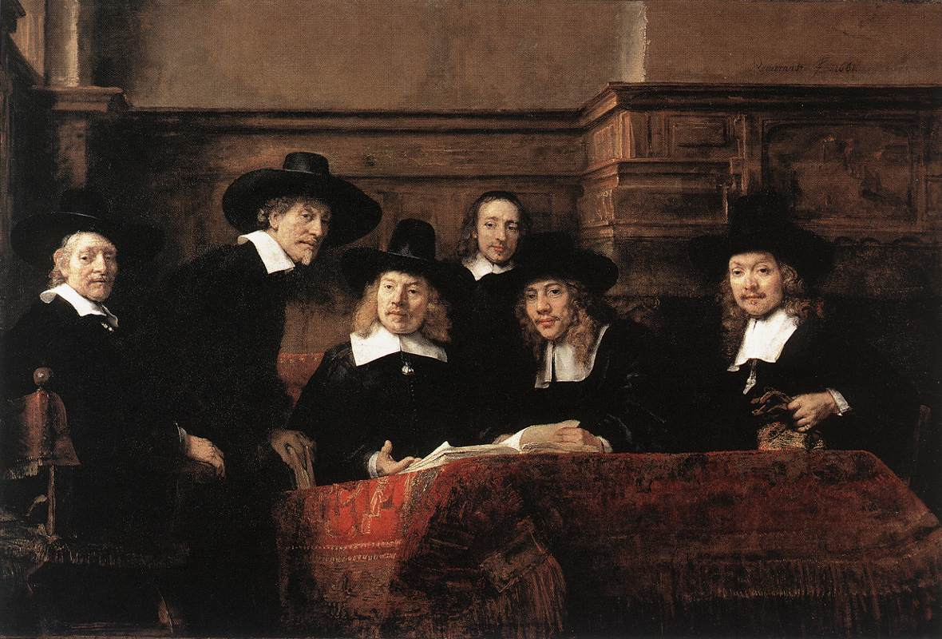
Sampling Officials of the Drapers Guild – Rembrandt - 1662

Slide 30
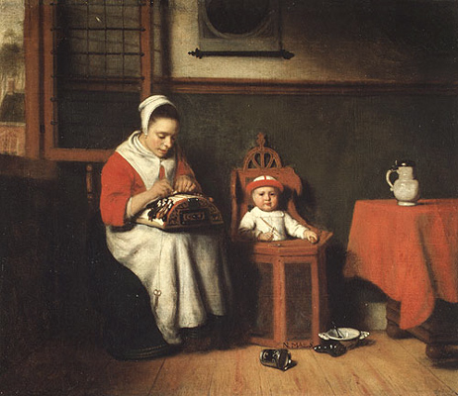
The Lace Maker Nicolaes Maes

Slide 31
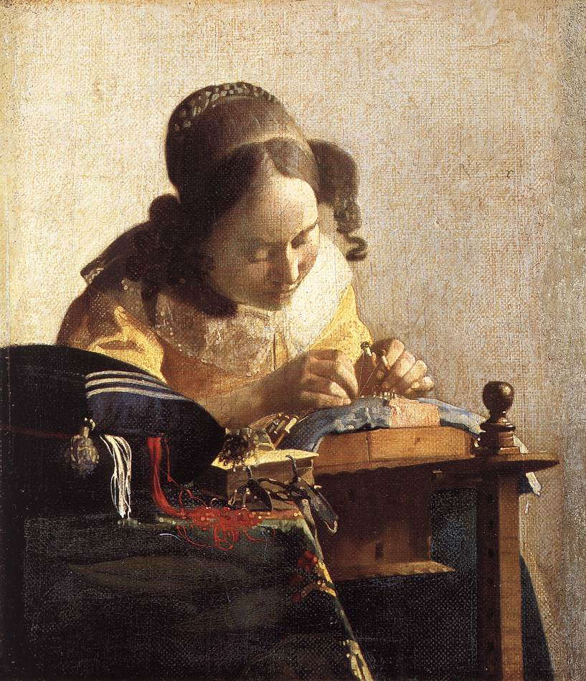
The Lace Maker Jan Vermeer, 1669-1670

Slide 32
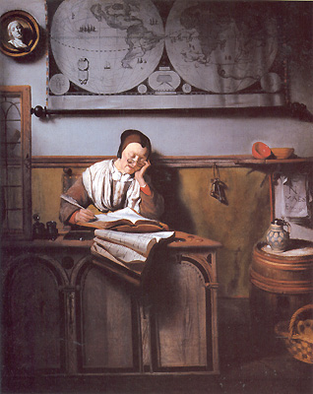
The Account Keeper Nicolaes Maes, 1656

Slide 33
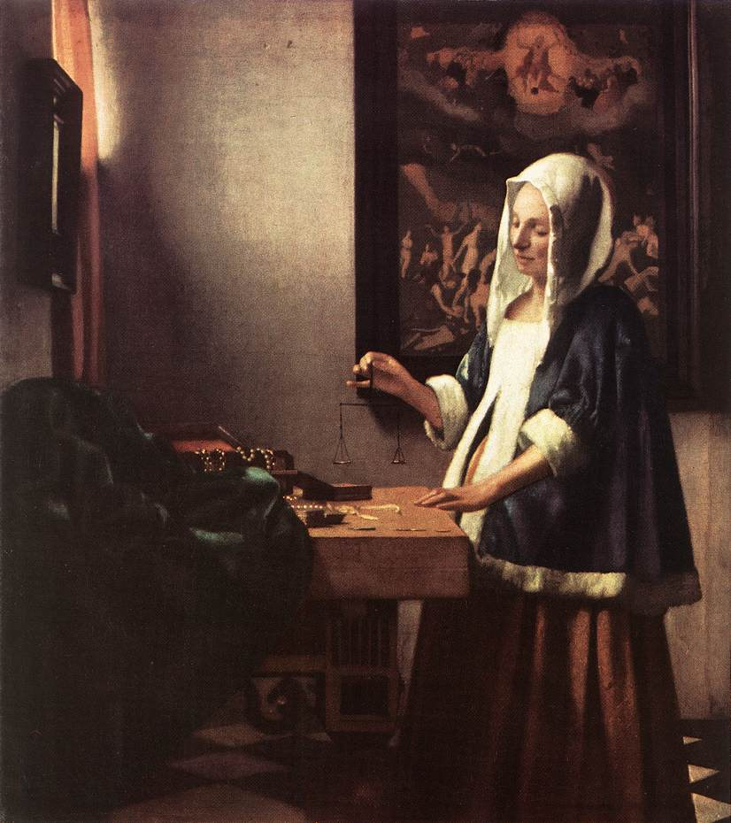
A Woman Holding a Balance Jan Vermeer, 1662

Slide 34
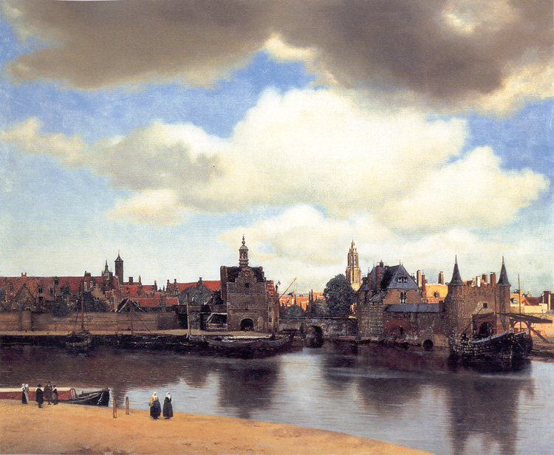
View of Delft Jan Vermeer, 1660-1661

Slide 35
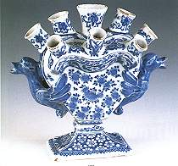
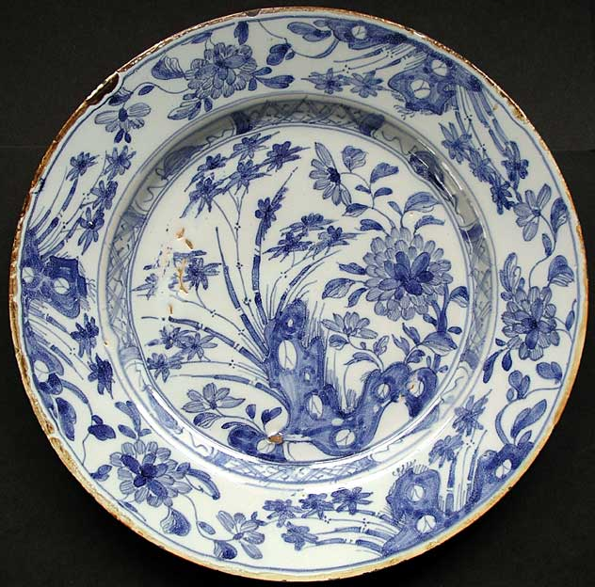
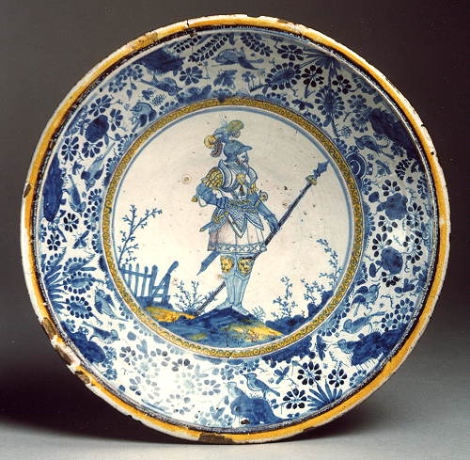
Dutch Delftware
English Delftware

Slide 36
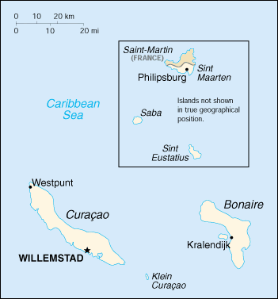
Dutch West India Company, 1621
Netherland Antilles

Slide 37
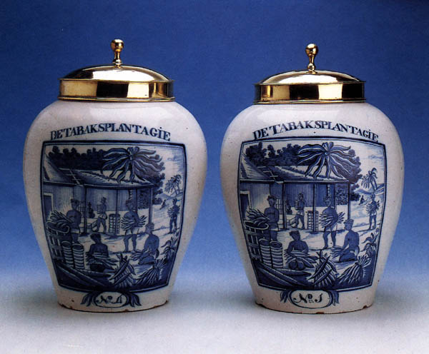
18c Delftware Tobacco Jars

Slide 38
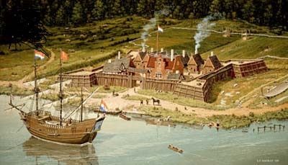
Fort Orange (Albany, NY) in New Netherlands

Slide 39
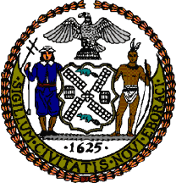
New Amsterdam (NYC)
Settled in 1624.
Official Flag of the NYC Seal of the City of NY.

Slide 40
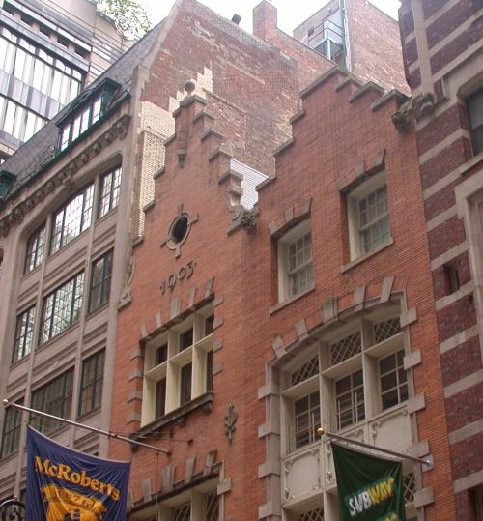
New Amsterdam (NYC)
Early 20c Dutch Revival Building in NYC.

Slide 41
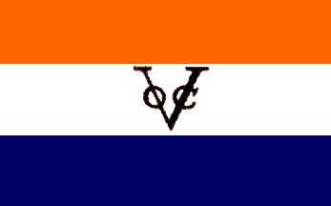
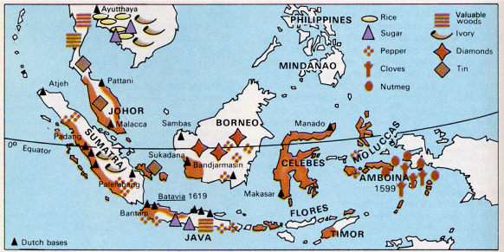
Dutch East India Company, 1602

Slide 42
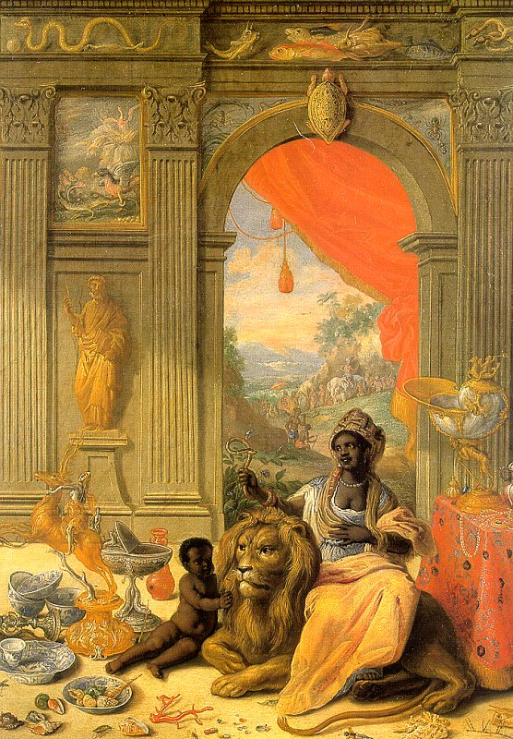
“Africa” Center Panel Jan van der Heyden, 1664-66

Slide 43
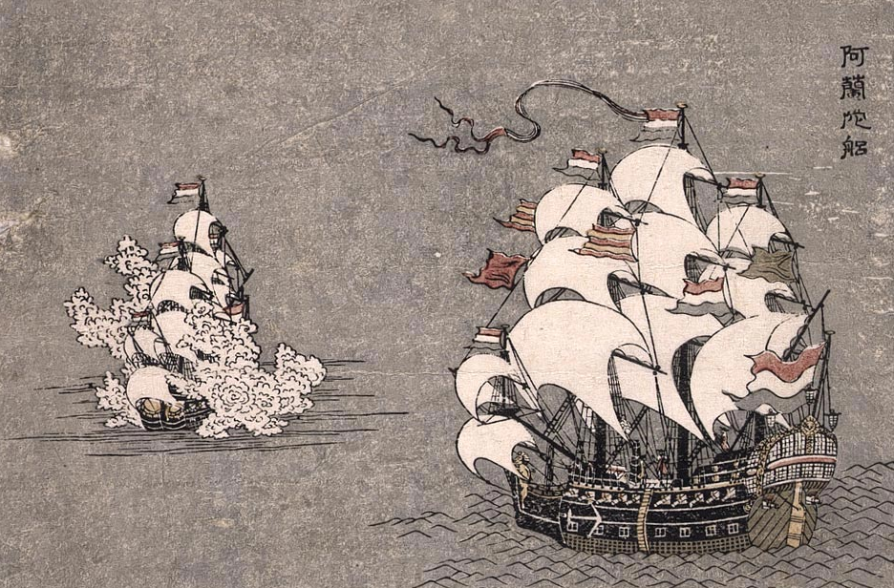
The Dutch in Japan, 18c

Slide 44
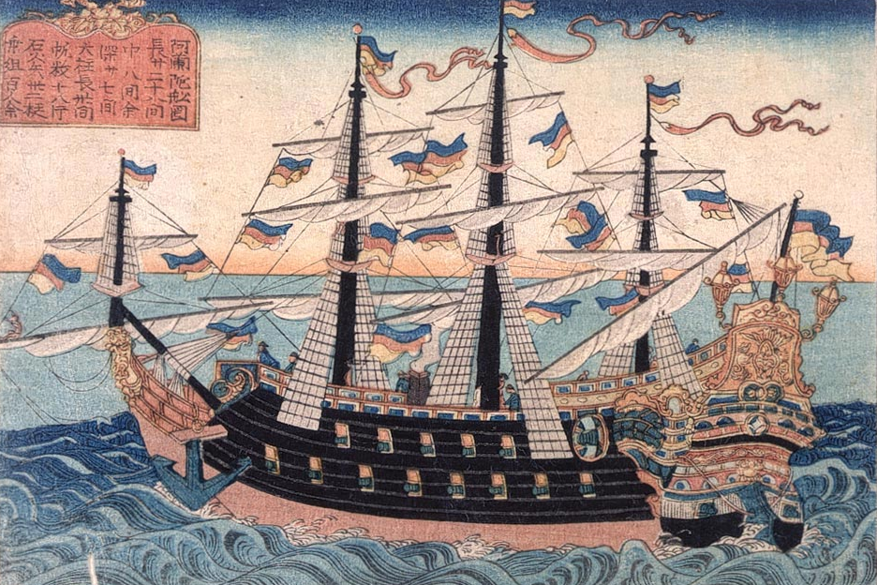
Dutch Ship in Nagasaki Late 18c

Slide 45
Dutch
Intellectual
Life

Slide 46
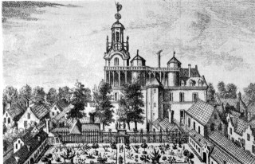
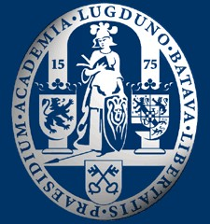
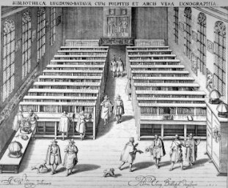
University of Leiden, 1575
By 1645, largest university in the Protestant world.
The separation of the strong provinces hindered the power of any church to control intellectual life in the Dutch Republic!

Slide 47
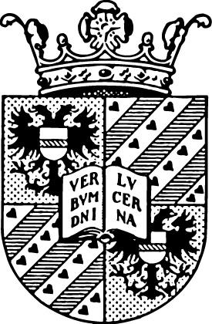
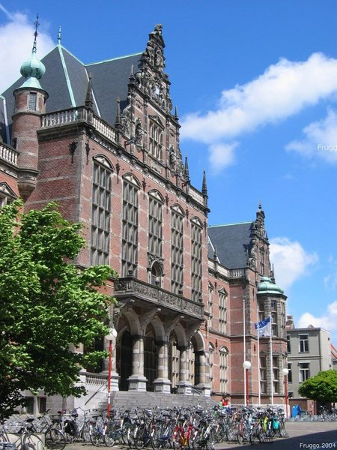
University of Gröningen, 1614
With Leiden, they were the first international universities.
Half of the students were foreigners.

Slide 48
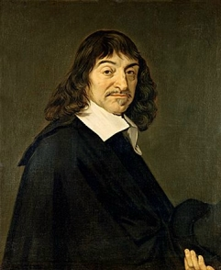
René Descartes
The French philosopher lived in Leiden from 1628 to 1649.

Slide 49
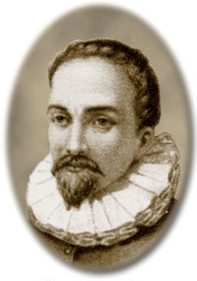
Dutch Optics: The Telescope
Most agree that the telescope was invented by Hans Lippershey in 1608.

Slide 50
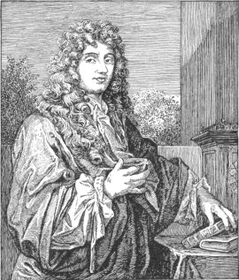
Astronomical Pioneer: Christiaan Huygens
Explanation of Saturn’s rings.
Wave theory of light.

Slide 51
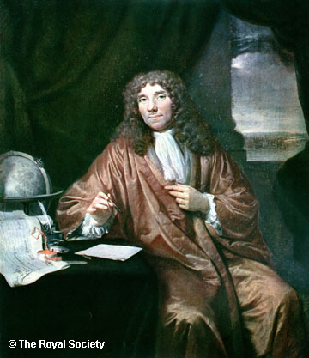
Anton van Leeuwenhoek: The Microscope & the Discovery of Micro-Organisms

Slide 52
Anatomy Lecture of Dr. Nicolaes Tulp – Rembrandt, 1632

Slide 53
(detail) Anatomy Lecture of Dr. Nicolaes Tulp – Rembrandt, 1632

Slide 54
Jan Vermeer and Optics
Did Vermeer use some of the new discoveries in optics for painting?
Did he use lenses to project the image of the subject [camera obscura] onto the canvas?
It is argued that van Leeuwenhoek was the model for his painting, “The Astronomer.”

Slide 55
The Astronomer Jan Vermeer, 1668

Slide 56
The Geographer Jan Vermeer, 1668-1669

Slide 57
Girl Reading a Letter with the Window Open - Jan Vermeer, 1657

Slide 58
The Music Lesson Jan Vermeer, 1662-1665

Slide 59
Dutch
Politics

Slide 60
The Spanish Hapsburgs & Europe (1556)
Netherlands
Philip II consolidated Hapsburg lands at the end of the 16c.

Slide 61
The Night Watch – Rembrandt, 1642

Slide 62
The Spanish Netherlands: Union of Utrecht, 1579
The United Provinces still recognized Spanish rule, but…

Slide 63
Dutch Politics
What happened between 1572 and 1609?

Slide 64
The Netherlands (1609)
In 1581 the Dutch claimed independence from Spain… remember?

Slide 65
The Dutch Federation
REGENTS
- provincial level
- held virtually all the power
- strong advocates of local independence
STADHOLDER
- States General representative from each province
- responsible for defense and order
STATES GENERAL
- federal assembly met at the Hague
- foreign affairs (war)
- all issues had to be referred to the local Estates

Slide 66
Count William II Granting Privileges Cesare van Everdingen, 1654

Slide 67
Anglo-Dutch Trade Wars
First Anglo-Dutch War: 1660-1665
Second Anglo-Dutch War: 1665-1667
Third Anglo-Dutch War: 1674-1678
King William III Queen Mary II ascend the throne of England in 1689 after the Glorious Revolution.

Slide 68
William III of England: “Dutch William”
The final “revenge” of the Dutch?

Slide 69
Factors of Dutch Decline
Economic prosperity >> stagnation
Leadership declines > disunity
GB rose as a naval power
GB passed them technologically
Dutch banking remained strong, but other banks developed
Which factors do you think MOST directly led to the decline of the Dutch as a world power in the 18th century?

