Slide 1
Space
Rubenstein Chapter 1.9

Slide 2
Space
Space = the physical gap between two objects.
Geographers observe & think about:
How objects are distributed across space, patterns
How people, objects & activities are arranged in space
Ask why

Slide 3
Space
Distribution = the arrangement of a feature in space
3 Properties of distribution: Density, Concentration, and Pattern
Remember: Geographic Distribution =
Density,
Concentration, and
Pattern

Slide 4
Space: Density
Density = the frequency with which something occurs in space(people, houses, cars, trees)
Density = # of feature divided by land area
REMEMBER: A large number of a feature, by itself, DOES NOT guarantee a high density
Which area has a higher Car Density?
A. Weis-Land: 135,000 cars in
100 square miles
B. Kolo-Land: 115,000 cars
60 square miles
Write down & explain your answer

Slide 5
Space: Concentration
Concentration = extent / how far apart a feature is spread over space
Objects close together = “clustered”
Objects far apart = “dispersed”
Concentration comparison requires:
Same number of objects in the same amount of area
Concentration DOES NOT EQUAL Density
https://content.openclass.com/eps/pearson-reader/api/item/33c1ac75-46ce-4867-ae30-5281538f14a6/1/file/RubensteinCHG3-071415-MB/OPS/s9ml/chapter01/filep7000496834000000000000000000716.xhtml

Slide 6
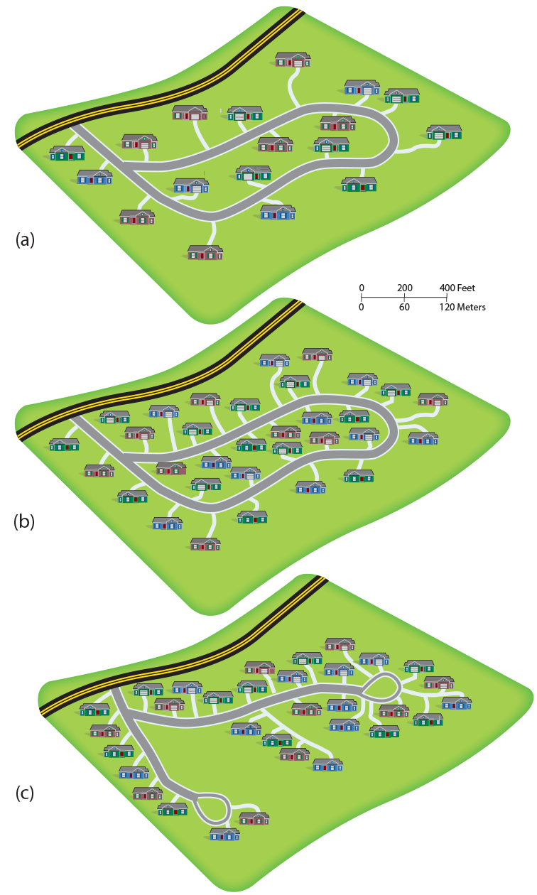
Concentration ≠ Density
View diagrams A, B and C of a tract of houses…
Which is the most dense?
Which is clustered?
Which is dispersed?

Slide 7
Space- Pattern
Pattern = the geometric arrangement of objects in space
Features are organized in a geometric pattern, whereas others are displaced randomly or irregularly
Example: Arrangement of houses along a street or stations along a subway line or trees along a street = pattern
Objects are often arranged in a square or rectangular pattern
https://content.openclass.com/eps/pearson-reader/api/item/33c1ac75-46ce-4867-ae30-5281538f14a6/1/file/RubensteinCHG3-071415-MB/OPS/s9ml/chapter01/filep7000496834000000000000000000716.xhtml

Slide 8
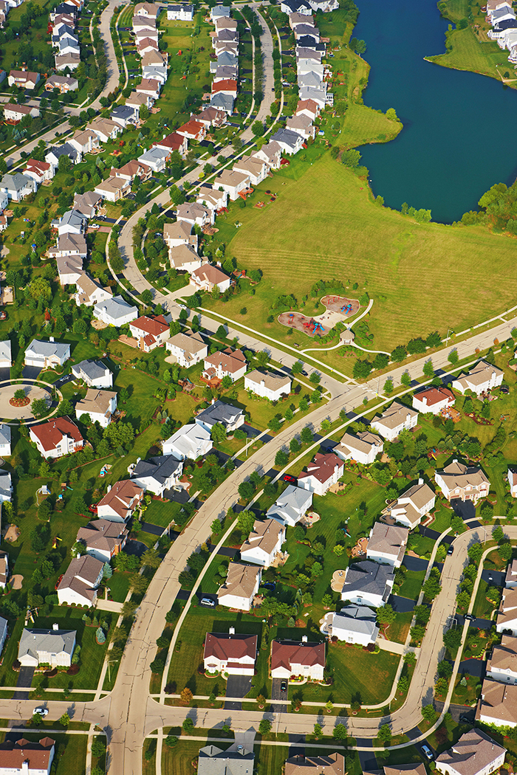
Pattern

Slide 9
“Build a Perfect Neighborhood” Activity (E): Space: Density, Concentration, and Pattern
Build a community that must include:
At least 24 families
Houses/Apartments that are either:
- Single family homes (1 fam.)
- Multi-family apartment buildings (2+ fam.)
At least two public places
Have equal amount of area (one sheet of paper)
Things to consider when building your community:
How many residents (Density)?
Private Space vs Public (communal) Space
Build Up vs. Build Out
How many roads/driveways will you use?
Patterned vs. Random
Clustered or Dispersed

Slide 10
“Building a Community” Activity Density and Concentration
Essential Question:
1.) What is the concentration of your community, dispersed or clustered? Explain Why!
(Hint: Houses vs Apartments)
2.) If a developer asks you to change the layout of YOUR community to accommodate a higher density of residents, what is a possible solution to this problem? Explain Why!
3.) Take a second to think about how you designed your community… Would you say that your community is patterned, or is it irregular? Explain Why!

Slide 11
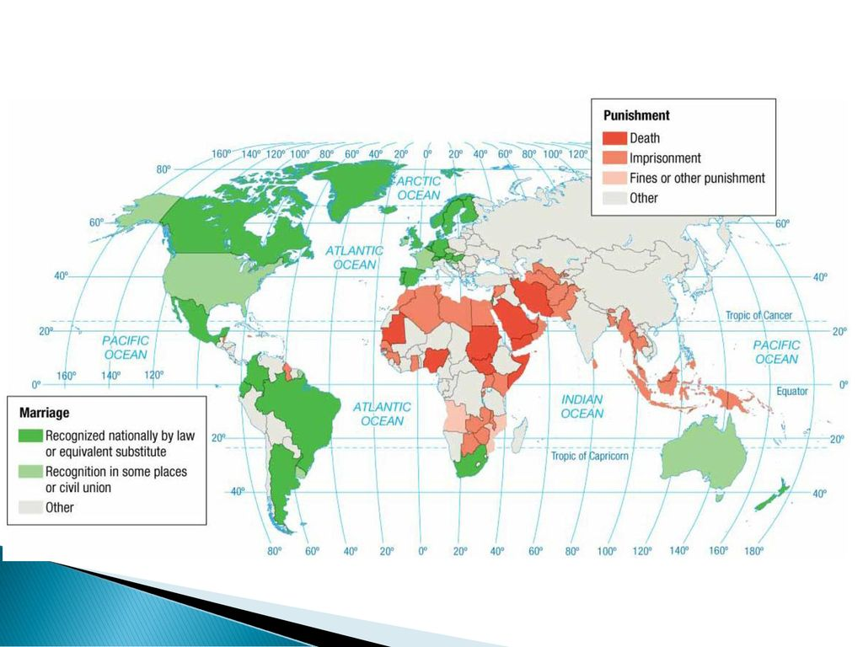
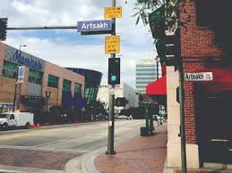
1.10: Space & Cultural Identity
Cultural groups compete to organize living space…
Gender, Ethnicity, & Sexuality influence space & its use
Cultural groups / ID influence movement & settlement
Whose job dominates a couple’s choice of location?
How does sexuality influence settlement?
Where do ethnic minorities settle?

Slide 12
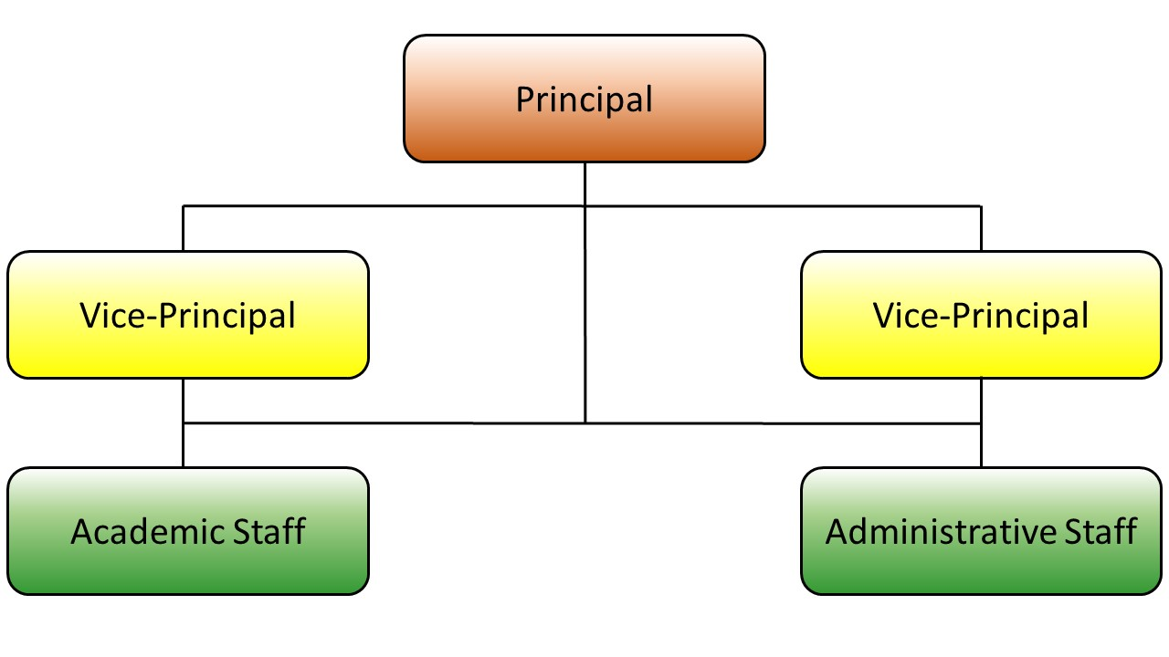
1.11: Space & Diffusion - Spreading of Features
Hearth / Node = where innovation starts
Relocation Diffusion = spread by physical movement
Expansion Diffusion = spread & adding to what is there
How does Expansion Diffusion occur?
Hierarchical Diffusion: based on power or authority
Contagious Diffusion: rapid, widespread… goes VIRAL (ex. Social media)
Stimulus Diffusion: adopted / copied

Slide 13
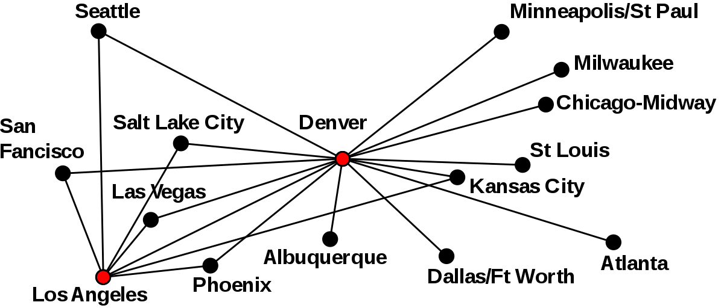
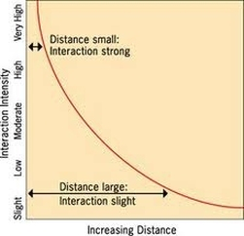
1.11: Spatial interaction - Networks
Network = Chains of communication that connect… Hub & Spoke
Distance Decay:
Closer together = better connection
Far away = less connection

Slide 14
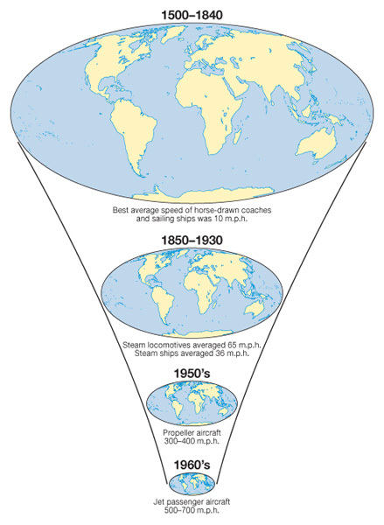
1.11 Space-Time Compression
Technology makes connection easier AND faster
Travel & Communication speed improve connections

Slide 15
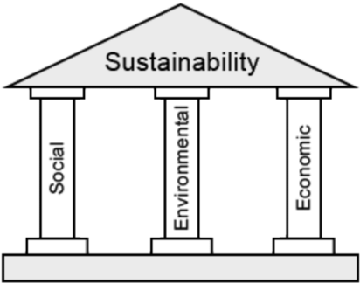
1.12: Sustainability of Resources
Resource = a substance that is useful to people, is accessible & socially acceptable to use
Sustainability = using Earth’s resources in a way to ensure future availability
Social – Environmental – Economic Aspects
Ecology: Responsible care of ecosystems (air, land, water, life)

Slide 16
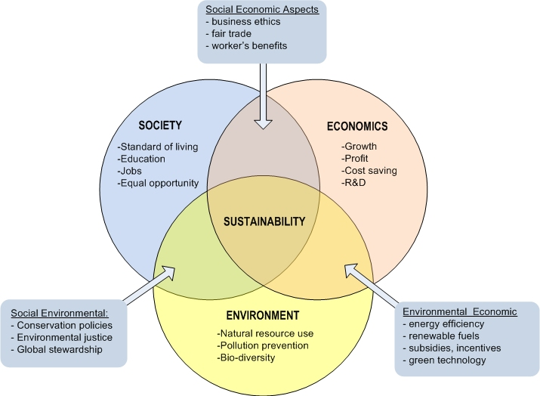
Sustainability: Pillars & Connections

Slide 17
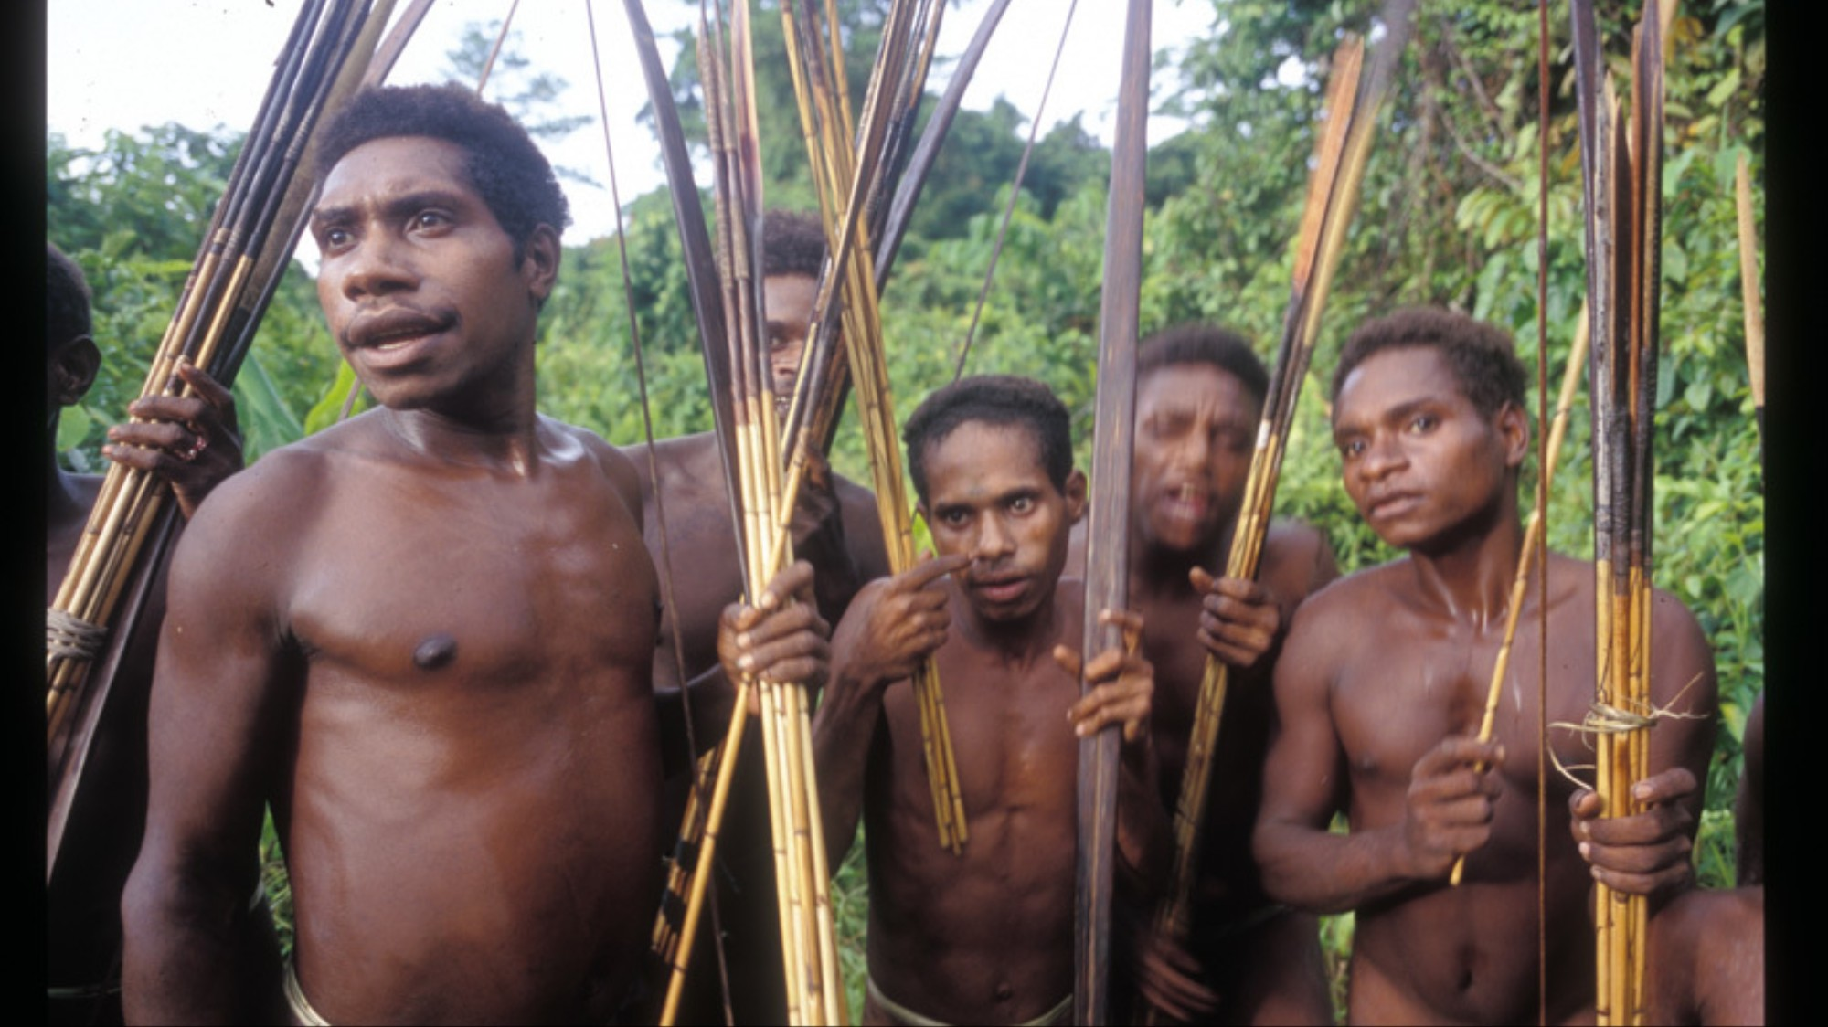
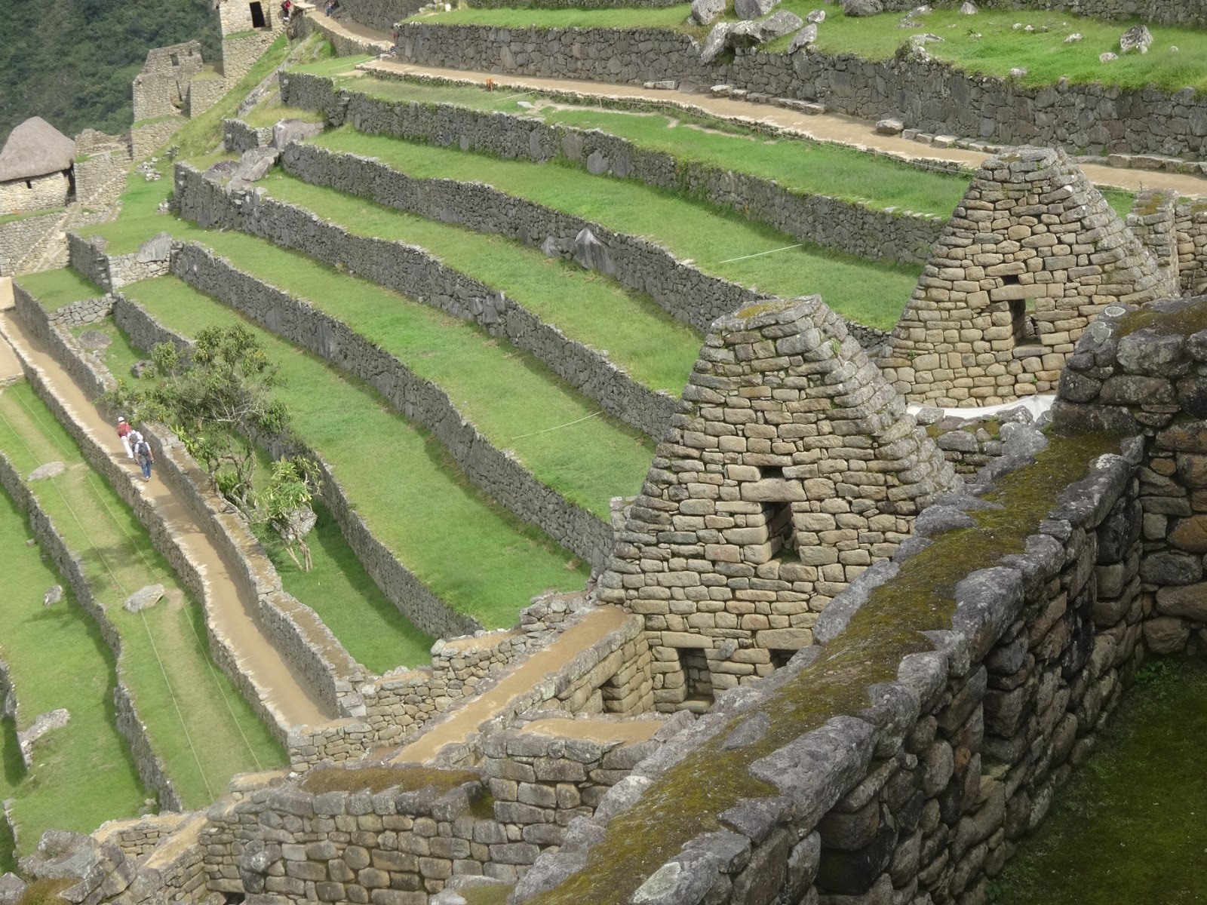
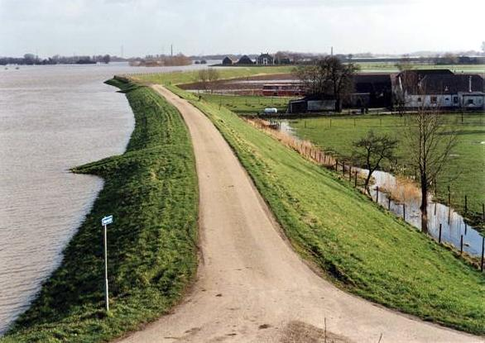
1.13 Human Interaction w/ Environment
Humans modify the environment with purpose
Environmental Determinism = Physical environment caused social development
Vs
Possibilism = Environment limits human action BUT humans adjust & create alternatives

