Slide 1
World War 1 Propaganda
A Tool to Influence
What is the overall message of each piece?
What action is each piece calling the reader / observer to take?
What techniques are used to generate the action?
Evaluate the effectiveness of each piece & explain your opinion.

Slide 2
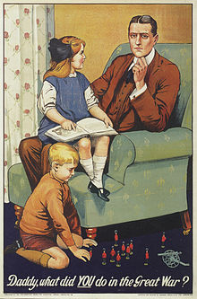
Document A: British

Slide 3
Document B: British

Slide 4
Document C: British

Slide 5
Document D: British

Slide 6
Document E: British

Slide 7
Document F: Canada

Slide 8
Document G: British

Slide 9
Document H

Slide 10
Document I: British

Slide 11
Document J: USA

Slide 12
Stimulus Based SAQ Practice: Answer each prompt below in a paragraph of 6-8 sentences.
1: Identify TWO propaganda examples that you believe are the MOST effective. Explain.
2: Identify TWO propaganda examples that you believe are the LEAST effective. Explain.

