Slide 2
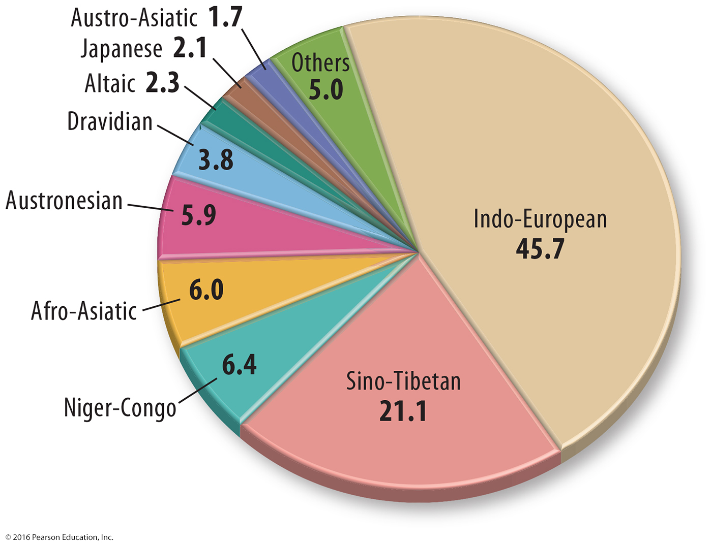
5.1 Classifying Language
Language defined:
A language family = collection of languages related through a common ANCIENT ancestral language

Slide 3
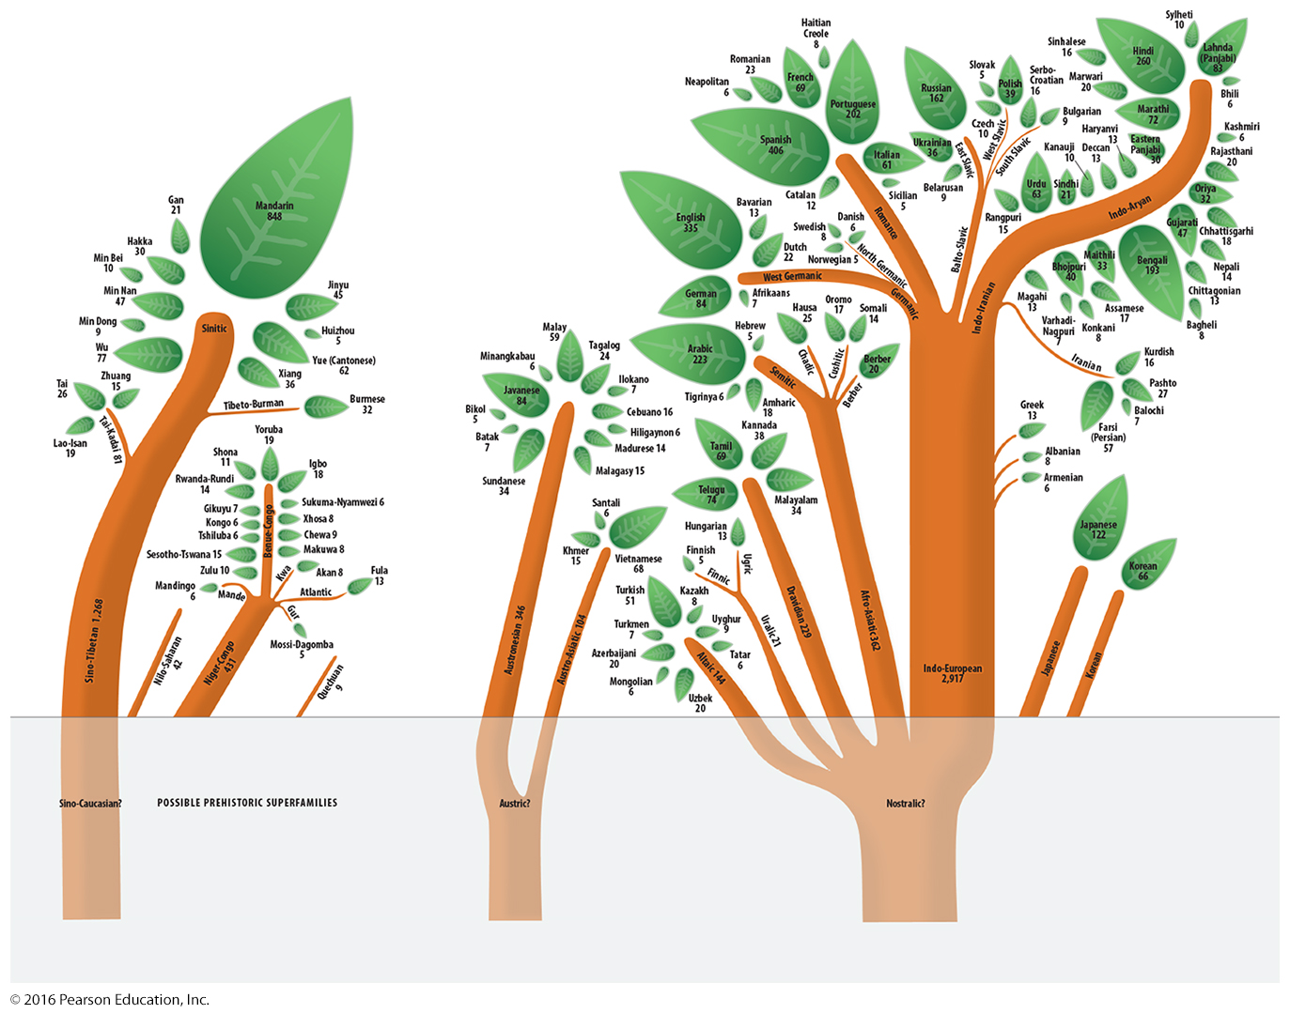
5.1 Classifying Language
Language Families & Branches

Slide 4
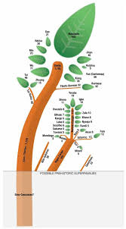
5.1 Classifying Language Branches
Language Branch =
A collection of languages within a family related through a common, ancient ancestral language

Slide 5
5.1 Classifying Language
Language Group =
A collection of languages within a branch that…
Share a common origin
Display many similarities in grammar and vocabulary.

Slide 6
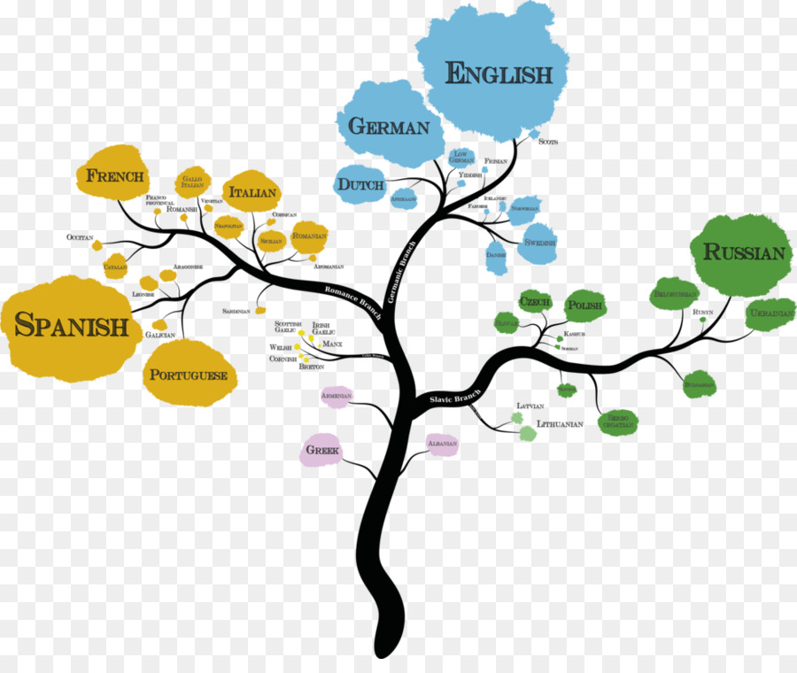
Common Language Branches & Groups
Germanic
Romance
Balto-Slavic

Slide 7
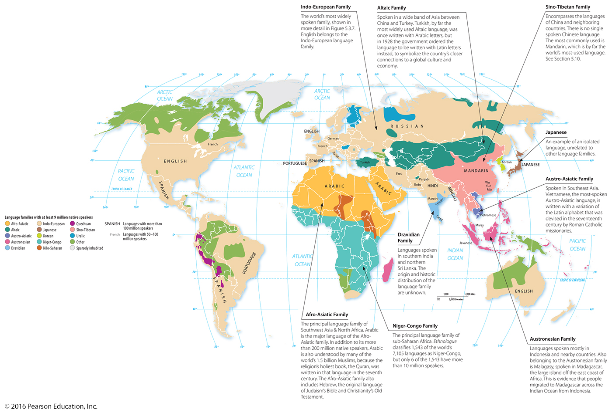
5.2 Distribution of Language Families
13 language families have at least 9 million native speakers.

Slide 8
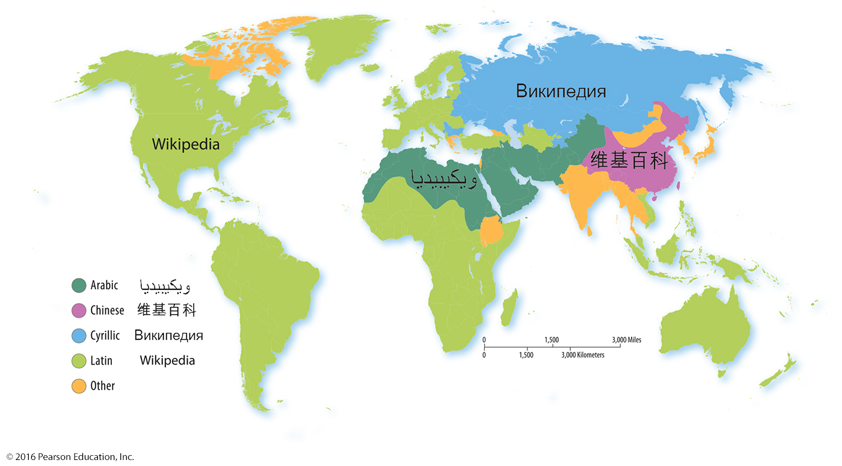
5.2 Distribution of Language Families
Many languages have a literary tradition, or a system of written communication.
Most written languages use one of four main writing systems: Arabic, Chinese, Cyrillic, Latin

Slide 9
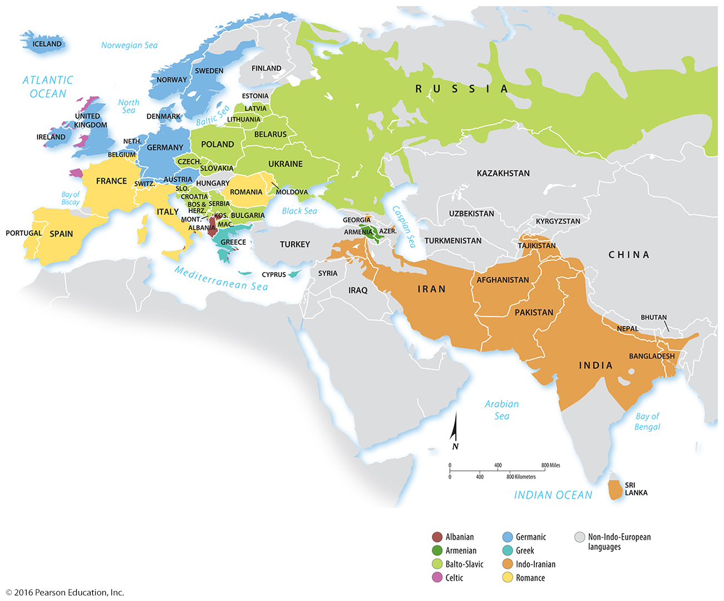
5.3 Indo-European Language Distribution: 8 Branches, but 4 Main…
Main Four =
Balto-Slavic
Indo-Iranian
Germanic
Romance

Slide 10
5.4 Origin & Diffusion of Languages
Origin and Diffusion of English
Celtic tribes around 2000 B.C.
Only a few words in modern English can be traced to the Celts, such as basket and flannel.
Angles, Saxons, and Jutes around A.D. 450
Germanic tribes from Denmark and Northern Germany pushed the Celts to remote areas and contributed around one-fourth of the words in modern English.

Slide 11
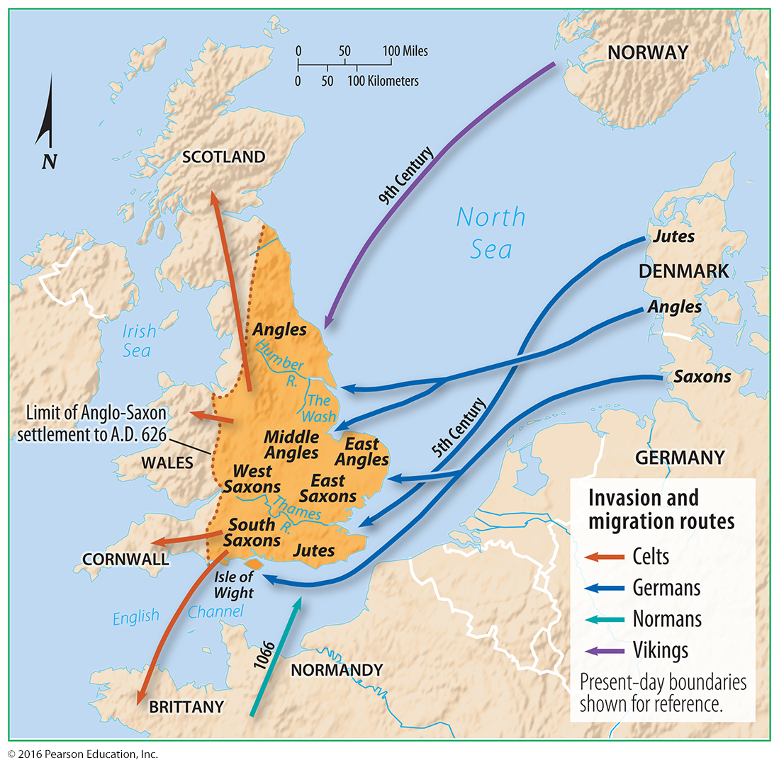
5.4 Origin & Diffusion of Languages
Origin and Diffusion of English

Slide 12
5.4 Origin & Diffusion of Languages
Origin and Diffusion of English
Vikings between 787 and 1171
Although unable to conquer Britain, Vikings remaining in the country contributed many words from their language, such as call, die, and leg.
Normans in 1066
Normans established French as the official language for the 300 years after the Norman invasion.
Romance languages contribute more than one-half of the words in English, either directly through French or through Latin.

Slide 13
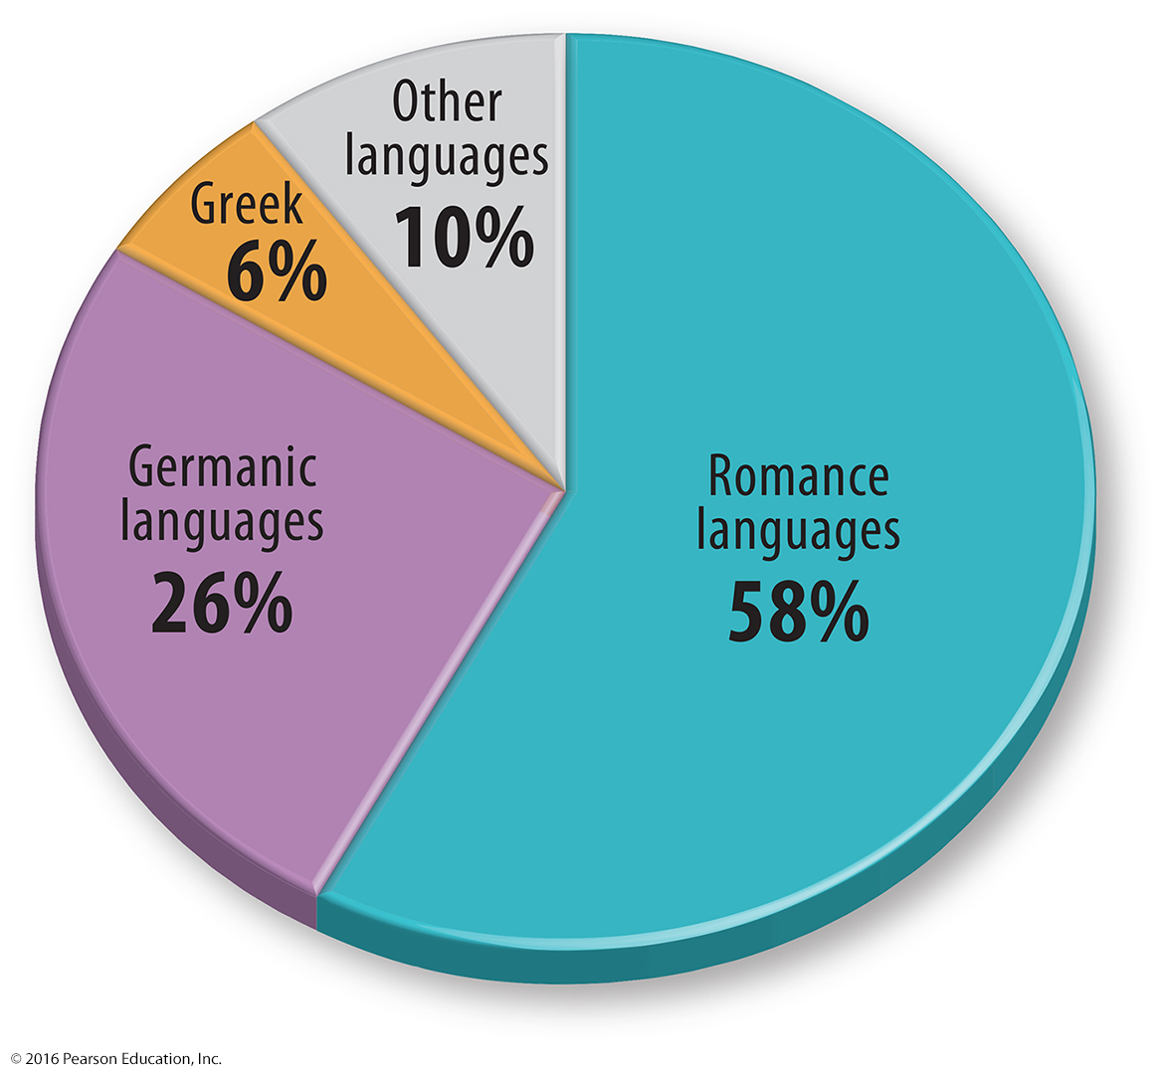
5.4 Origin & Diffusion of Languages
Origin and Diffusion of English

Slide 14
5.4 Origin & Diffusion of Languages
Origin and Diffusion of Indo-European
Linguists and anthropologists disagree on when and where Proto-Indo-European originated and the process and routes by which it diffused.

Slide 15
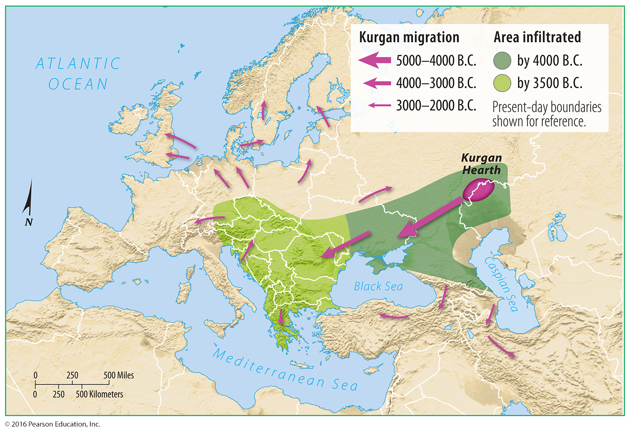
5.4 Origin & Diffusion of Languages
Origin and Diffusion of Indo-European
Nomadic Warrior Theory

Slide 16
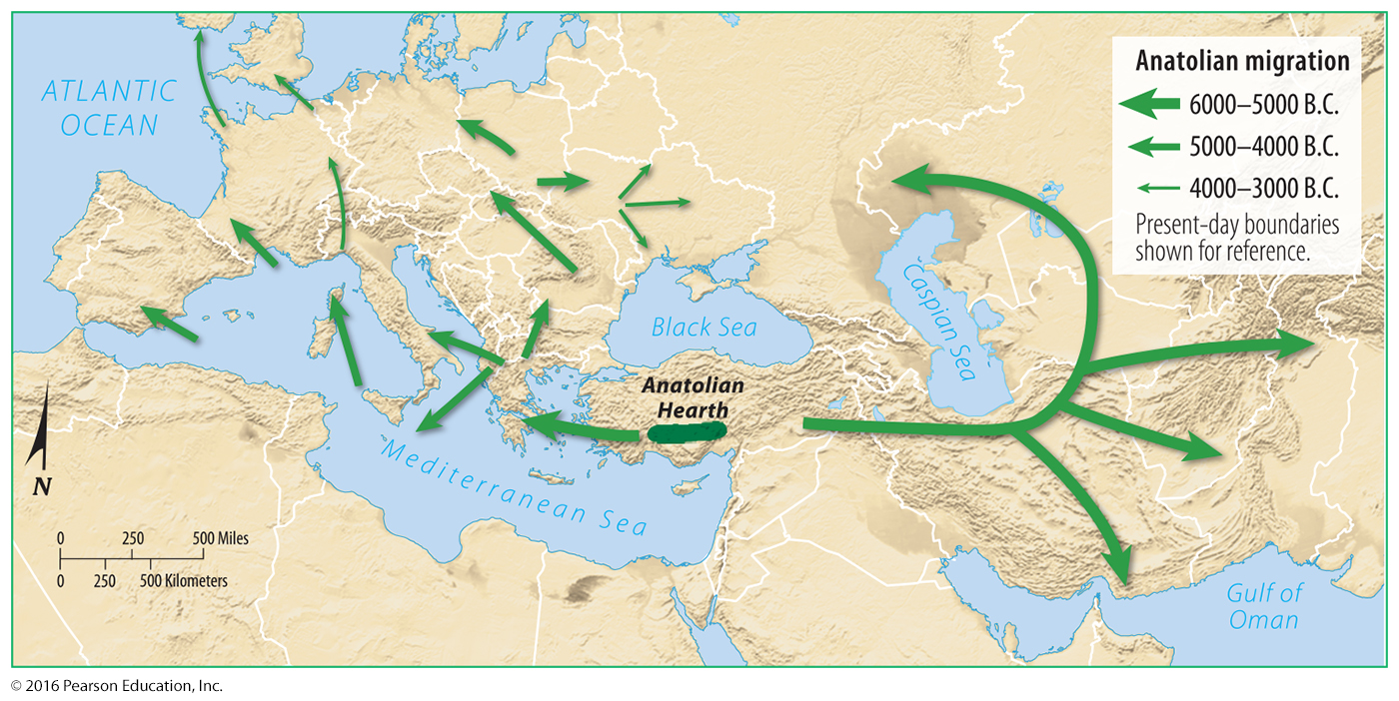
5.4 Origin & Diffusion of Languages
Origin and Diffusion of Indo-European
Sedentary Farmer Theory

Slide 17
5.5 Distribution of Dialects
Dialects in the United States
The national diffusion of distinctive dialects is a result of the westward movement of colonists from the three East Coast dialect regions.
These have been joined by a fourth that developed in the West.

Slide 18
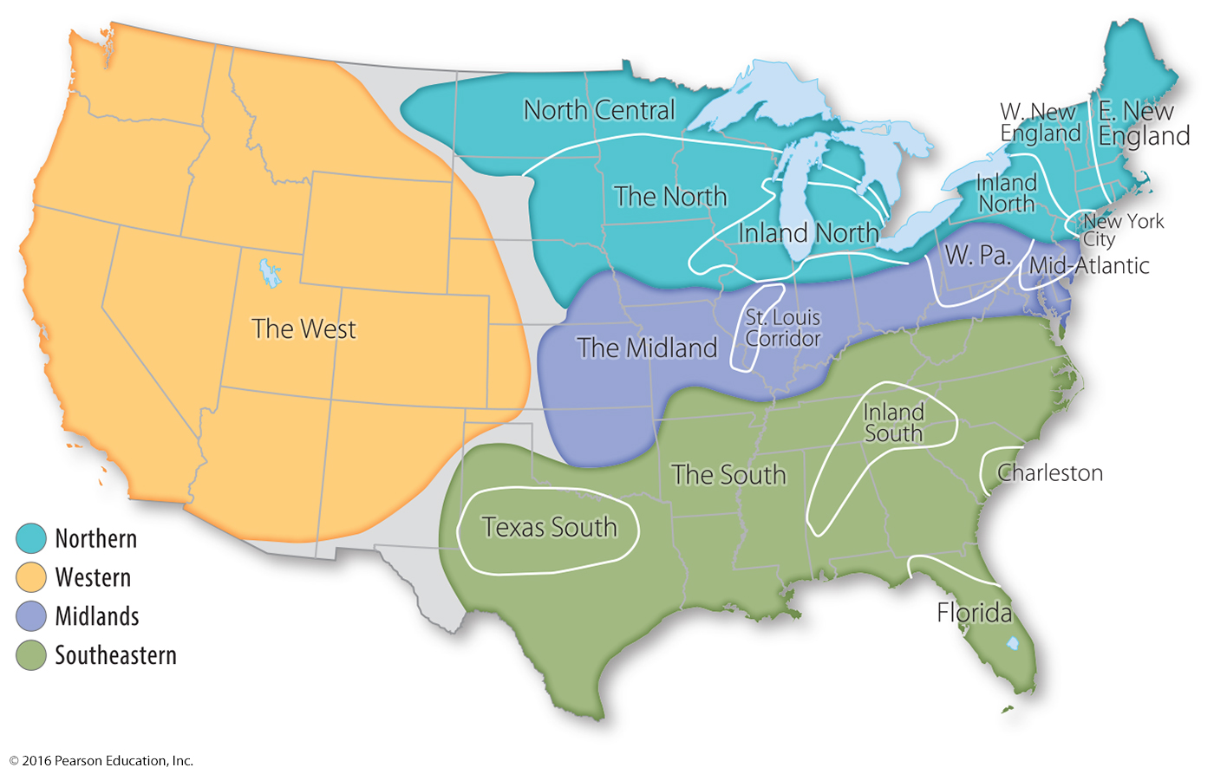
5.5 Distribution of Dialects
Dialects in the United States

Slide 19
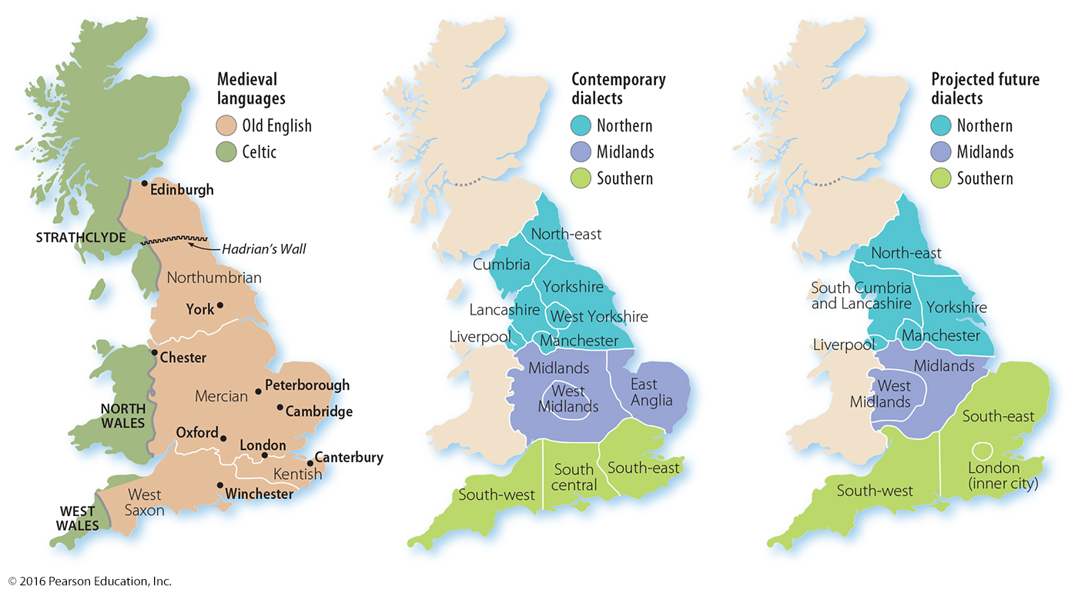
5.5 Distribution of Dialects
Dialects in the United Kingdom
Regional dialects in the United Kingdom are a legacy of the invasion of groups from Northern Europe that settled in different parts of Britain.

Slide 20
5.5 Distribution of Dialects
Dialects in the United Kingdom
U.S. English differs from U.K. English in three significant ways:
Vocabulary
Spelling
Pronunciation

Slide 21
5.6 Dialect or Language
Dialects Become Languages
The Romance languages we know today as French, Spanish, and Portuguese began as dialects of Latin (“Roman’s Language”).

Slide 22
5.6 Dialect or Language
Standardizing Dialects of a Language
Spanish
The Spanish Royal Academy, housed in a mansion in Spain’s capital, Madrid, tries to promote a single standard language.
Portuguese
A 1994 agreement standardized the way that Portuguese is written. Many people in Portugal were upset that the new standard language more closely resembled the Brazilian version.

Slide 23
5.6 Dialect or Language
Romance Language Examples
Creole languages
A creole is a language that results from the mixing of a colonizer’s language with an indigenous language. French Creole in Haiti is an example.
Italy’s languages
Several languages in Italy that have been traditionally considered dialects of Italian are now viewed by Ethnologue as sufficiently different to merit classification as languages distinct from Italian.

Slide 24
5.6 Dialect or Language
Romance Language Examples
Catalán
Once regarded as a dialect of Spanish, Catalán is now classified as a distinct language.
Valencian
Currently classified as a dialect, but its speakers clamor to have it recognized as a distinct language.
Galician
Many of its speakers would prefer to consider it a dialect of Portuguese, one of the world’s most widely used languages.

Slide 25
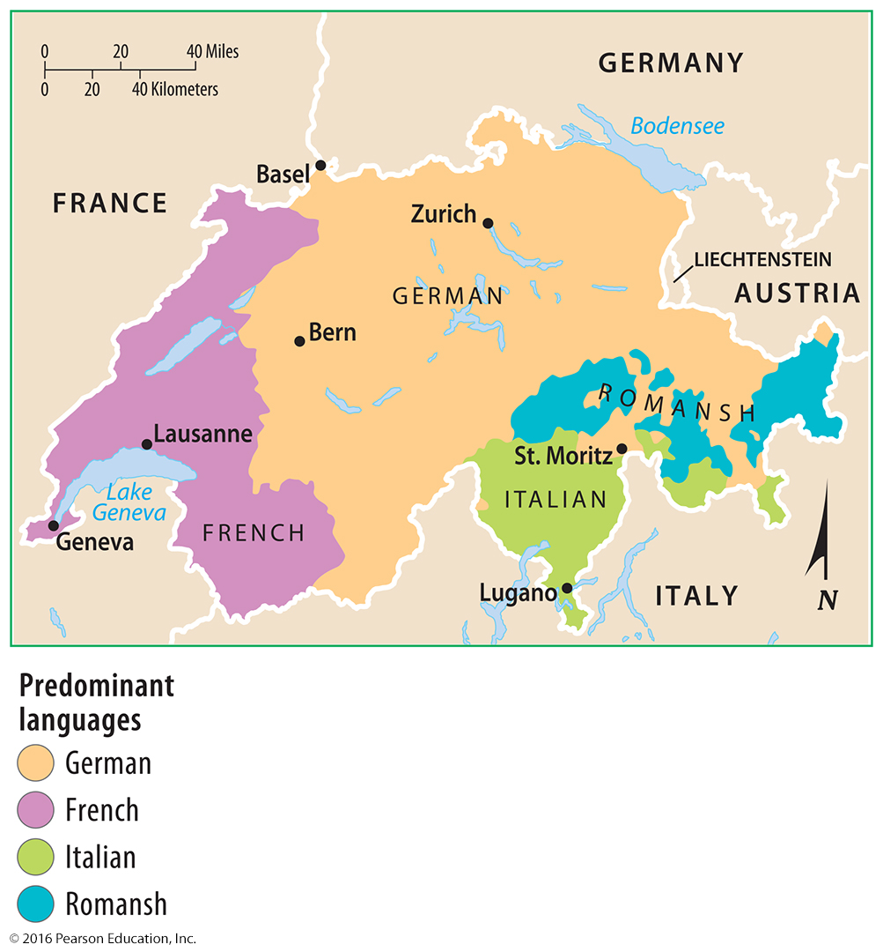
5.7 Multilingual Places
Switzerland: Institutionalized Diversity
The Swiss have institutionalized cultural diversity by giving considerable power to small communities.

Slide 26
5.7 Multilingual Places
Canada: Bilingual Autonomy
French is one of Canada’s two official languages, along with English.
French speakers comprise one-fourth of the country’s population and are clustered in Québec.
Confrontation has been replaced in Québec by increased cooperation between French and English speakers.

Slide 27
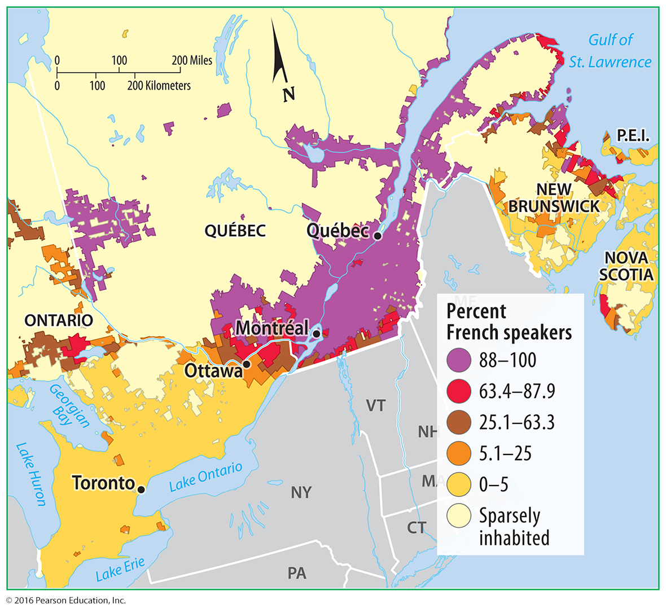
5.7 Multilingual Places
Canada: Bilingual Autonomy

Slide 28
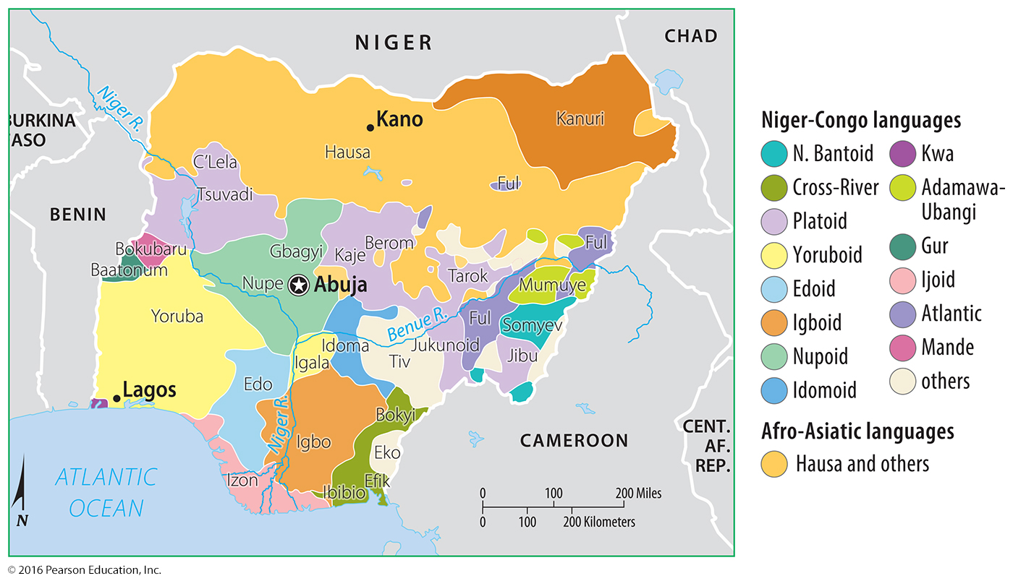
5.7 Multilingual Places
Nigeria: Spatial Compromise
To reduce regional tensions, Nigeria moved the capital from Lagos Abuja in the center of the country, where no language predominates.

Slide 29
5.7 Multilingual Places
Belgium: Barely Speaking
Southern Belgians (Walloons) speak French, whereas northern Belgians (Flemings) speak Flemish, a dialect of Dutch.
Each group controls an autonomous region.
The Flemish want independence, which would make Flanders one of Europe’s richest countries and Wallonia one of the poorest.

Slide 30
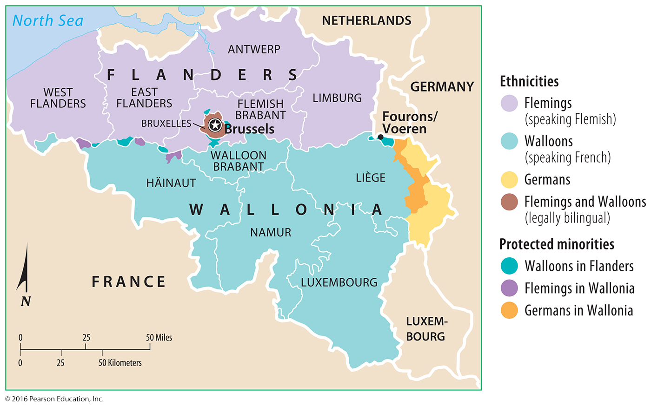
5.7 Multilingual Places
Belgium: Barely Speaking

Slide 31
5.8 Isolated & Extinct Languages
Endangered and Extinct Languages
Of the 7,105 living languages it identifies, Ethnologue classifies 906 of them as dying and 1,481 as in trouble.
An extinct language was once used by people in daily activities but is no longer in use.
The loss of many languages is a reflection of globalization.

Slide 32
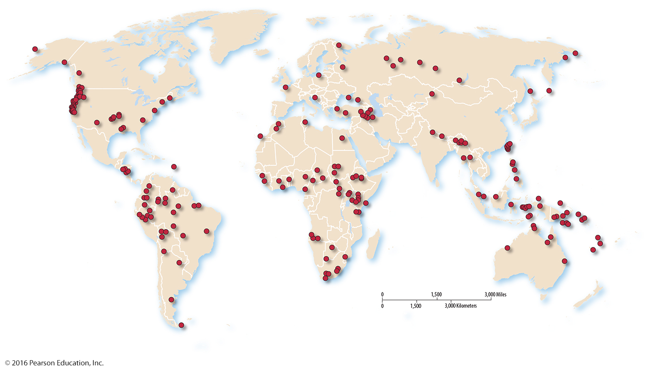
5.8 Isolated & Extinct Languages
Endangered and Extinct Languages

Slide 33
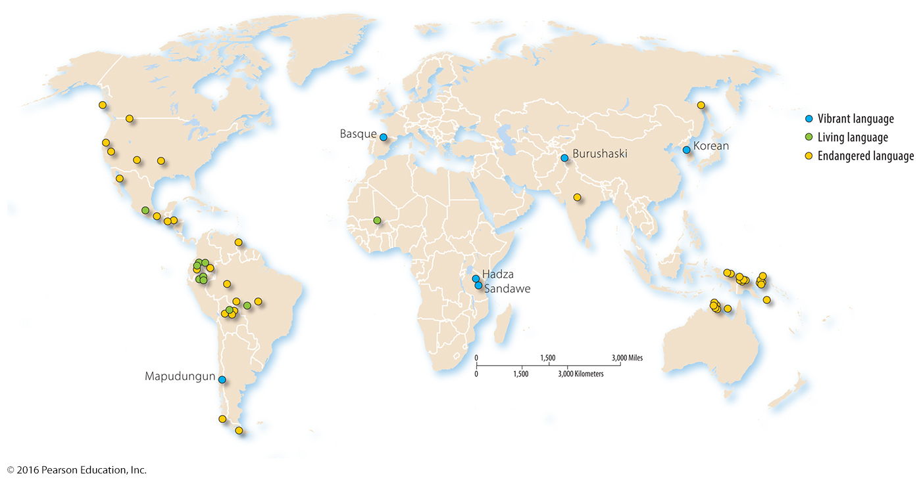
5.8 Isolated & Extinct Languages
Isolated Languages
An isolated language is a language unrelated to any other and therefore not attached to any language family.

Slide 34
5.9 Preserving Lesser-Used Languages
Preserving Languages
Welsh
Welsh was the dominant language of Wales until the nineteenth century, when many English speakers migrated there.
To help preserve the language, Welsh is a required school subject, road signs are in Welsh, and Welsh-language TV and radio programs are broadcast.

Slide 35
5.9 Preserving Lesser-Used Languages
Preserving Languages
Irish
Irish Gaelic is an official language of the Republic of Ireland, along with English.
English was imposed when the country was a colony of the United Kingdom.
Irish is now preserved in schools, signs, and broadcast media, like Welsh.

Slide 36
5.9 Preserving Lesser-Used Languages
Preserving Languages
Breton
In Brittany around 225,000 people speak Breton regularly.
Breton is not recognized as an official language in France, however.

Slide 37
5.9 Preserving Lesser-Used Languages
Preserving Languages
Scottish
Around 100,000 people speak Scottish Gaelic.
Cornish
Cornish became extinct in 1777, and the language was revived in the 1920s, but only a few hundred people are fluent.

Slide 38
5.9 Preserving Lesser-Used Languages
Reviving Languages
Hebrew
The language of daily activity in biblical times, Hebrew diminished in use in the fourth century B.C. and was thereafter retained primarily for Jewish religious services.
When Israel was established as an independent country in 1948, Hebrew became one of the new country’s two official languages, along with Arabic.

Slide 39
5.9 Preserving Lesser-Used Languages
Reviving Languages
Myaamia
No one has spoken this as a first language, the language of the Miami Tribe of Oklahoma, since the 1960s.
Daryl Baldwin, a Tribe member, became fluent in the language and is teaching it to his children as their first language.
An online dictionary has been created to aid in the language’s revival.

Slide 40
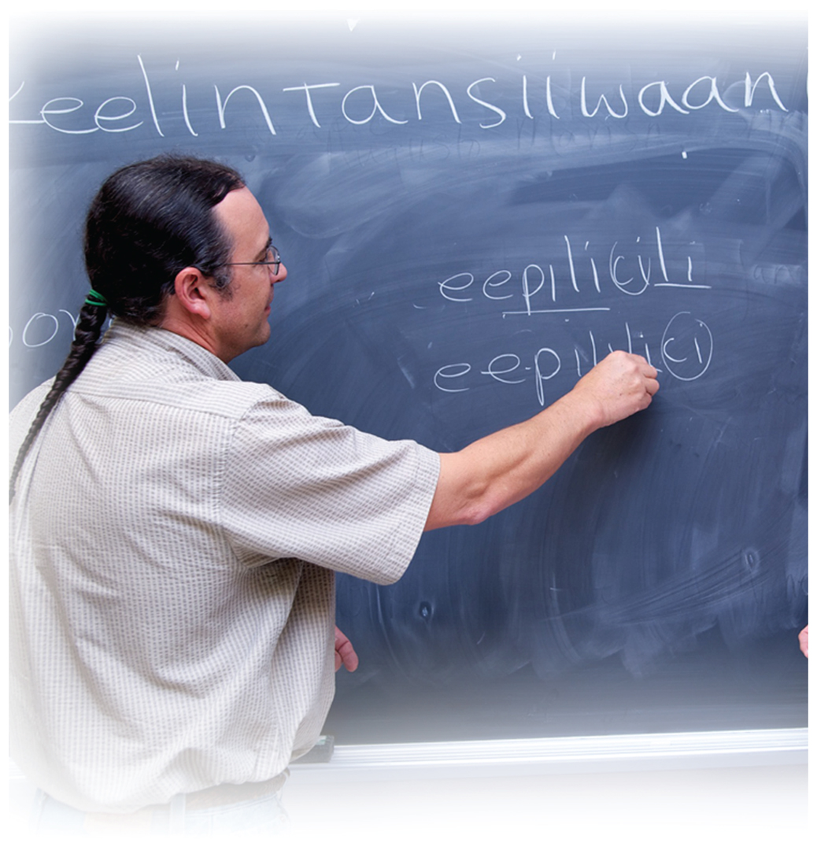
5.9 Preserving Lesser-Used Languages
Reviving Languages
Myaamia

Slide 41
5.9 Preserving Lesser-Used Languages
New Languages
Isolated languages continue to be identified and documented, and entirely new ones are invented.
For example, Koro Aka, a Sino-Tibetan language of Northeastern India, was discovered in 2008.

Slide 42
5.10 Diffusion of English
Lingua Franca
A lingua franca is a language mutually understood and commonly used to communicate by people who have different native languages.
The leading lingua franca in the contemporary world is English, and others include Swahili, Hindi, Indonesian, and Chinese.
A pidgin language adopts a simplified grammar and limited vocabulary of a lingua franca.

Slide 43
5.10 Diffusion of English
Diffusion of English into Other Languages
Franglais—a mix of French and English
Spanglish—a mix of Spanish and English
Denglish—a mix of German (Deutsch) and English

Slide 44
5.10 Diffusion of English
Chinese: The Next Lingua Franca?
By 2020, Chinese is expected to replace English as the most common online language and to become the most important language of social media.
Rather than sounds (as in English), Chinese languages are written primarily with logograms, which are symbols that represent words or meaningful parts of words.

Slide 45
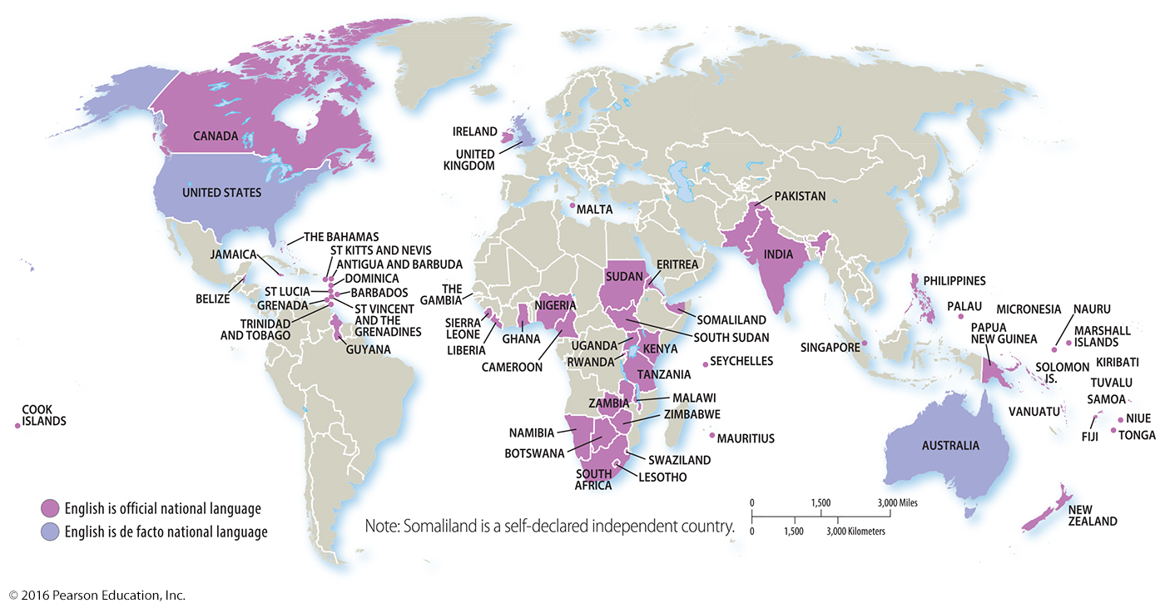
5.10 Diffusion of English
Global Distribution of English
The current distribution of English exists because of the history of British and contemporary American influence.

